Slide 1
Agenda for GEOG260/360 GIS & Land Change Models
Today
COVID has returned to campus. Use this room’s capacity for social distancing.
If you will be absent, then send email to professor and assistants before the class that you must miss.
New Hours for the GIS Help Desk. Send email to Lara and Apple to consult via zoom.
Introduction of Teaching Assistant Shushil Paudel
Discuss Assignment 1
September 11
See grading rubric and ask Questions on Assignment 1
Philosophies of Scenario Modeling versus Predictive Modeling
Discuss https://www.theguardian.com/environment/2023/jan/18/revealed-forest-carbon-offsets-biggest-provider-worthless-verra-aoe and a response at https://www.sylvera.com/blog/guardian-offsets-response
Introduction to Geomod
September 13
Assignment 1 is due at 4pm via Canvas. Each hour late incurs a one percentage point penalty.
Get instructions for Assignment 2
Geomod land change allocation model in TerrSet
September 15 Deadline to declare Pass/Fail Grade

Slide 2



Lara Jordan (Ljordan@clarku.edu) and Apple Gould-Schultz (AGouldShultz@clarku.edu) are 5th year Masters GIS students and this semester’s assistants at the GIS Help Desk. Lara Jordan took this course in fall 2020.
Lara Jordan Apple Gould-Shultz
Founder of SQUIDINK

Slide 3
Annual Deforestation Rate in the Brazilian Amazon
How would you create a recent trends scenario based on data?
Draw a straight line between two points, use the equation of a line to extrapolate into the future.
Or
Or use trendline in excel
-84%
190%
Fonte: Imazon
Source: PRODES, INPE

Slide 4
How should we extrapolate Recent Trends for each town?

Slide 5
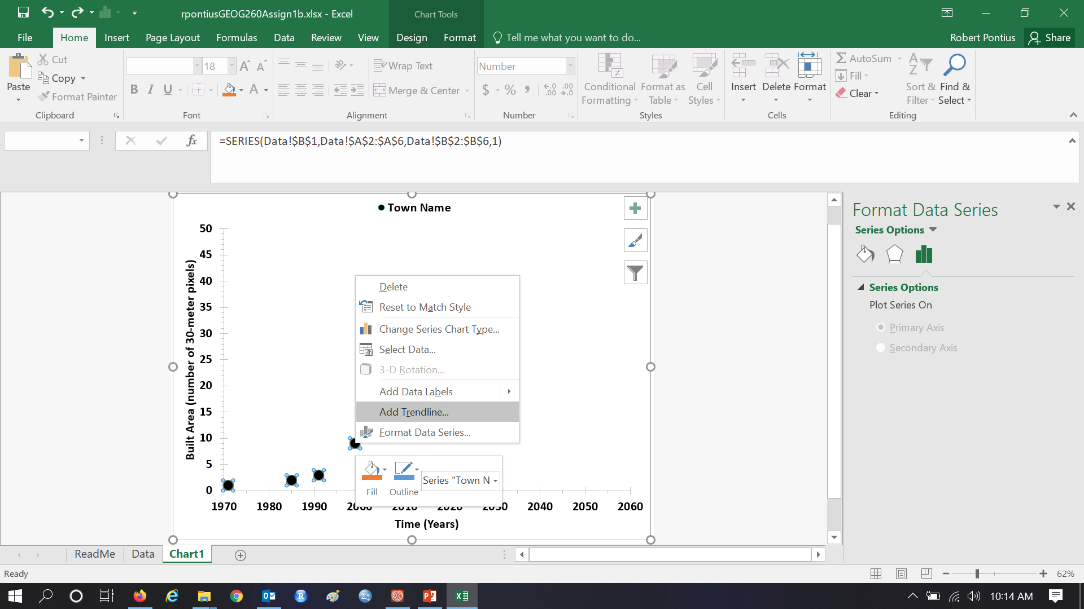
Excel will easily add a trendline using all the data.

Slide 6
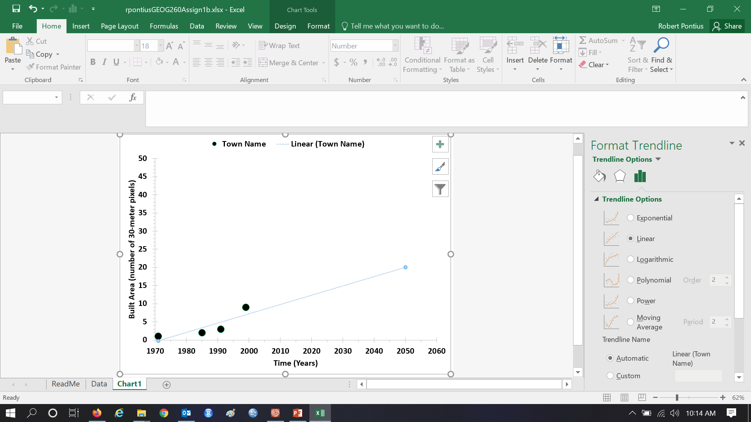
Linear is one of several ways to portray a trend.

Slide 7
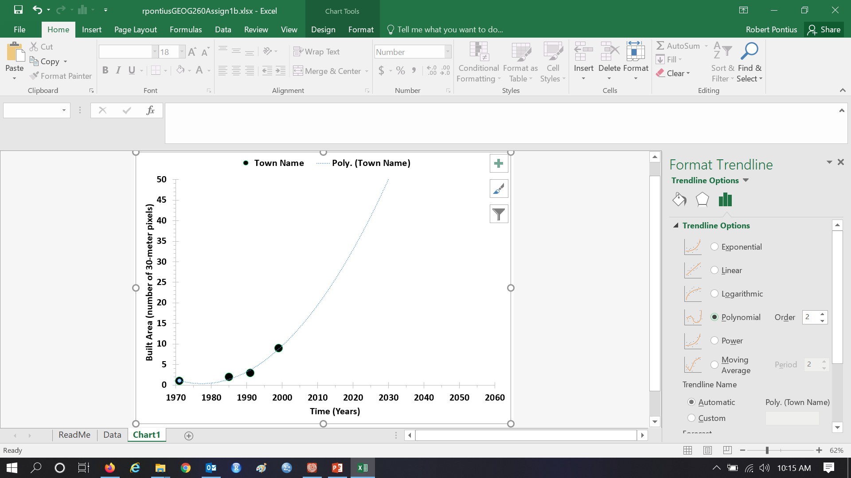
You can make a polynomial of order 2.

Slide 8
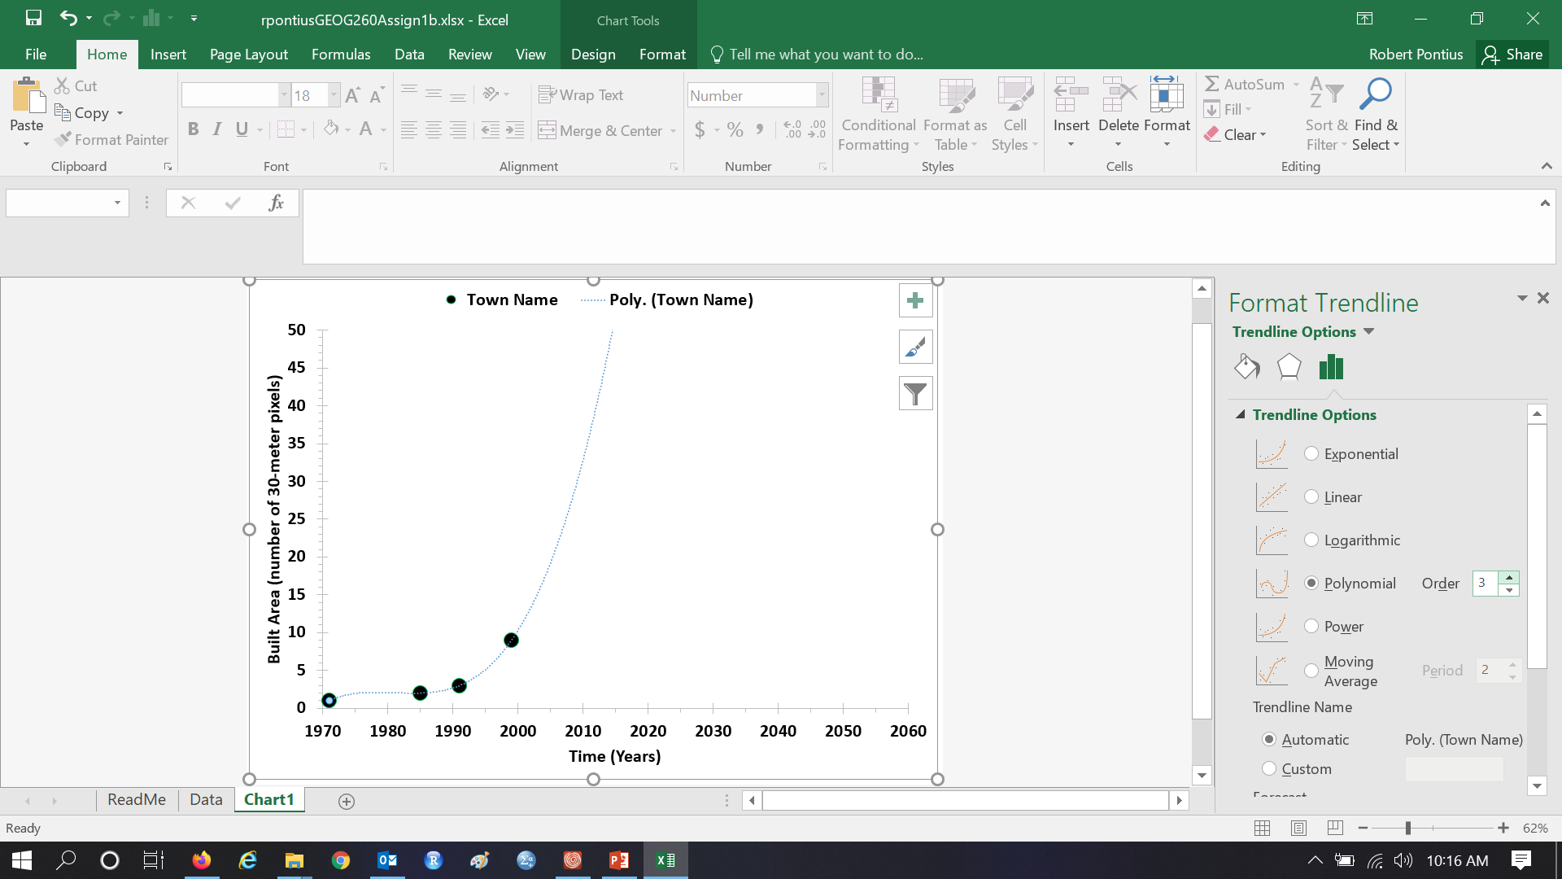
You can make a polynomial of order 3.

Slide 9

You can make an exponential trend.

Slide 10
These options never slow as a town approaches 100% built.

Slide 11

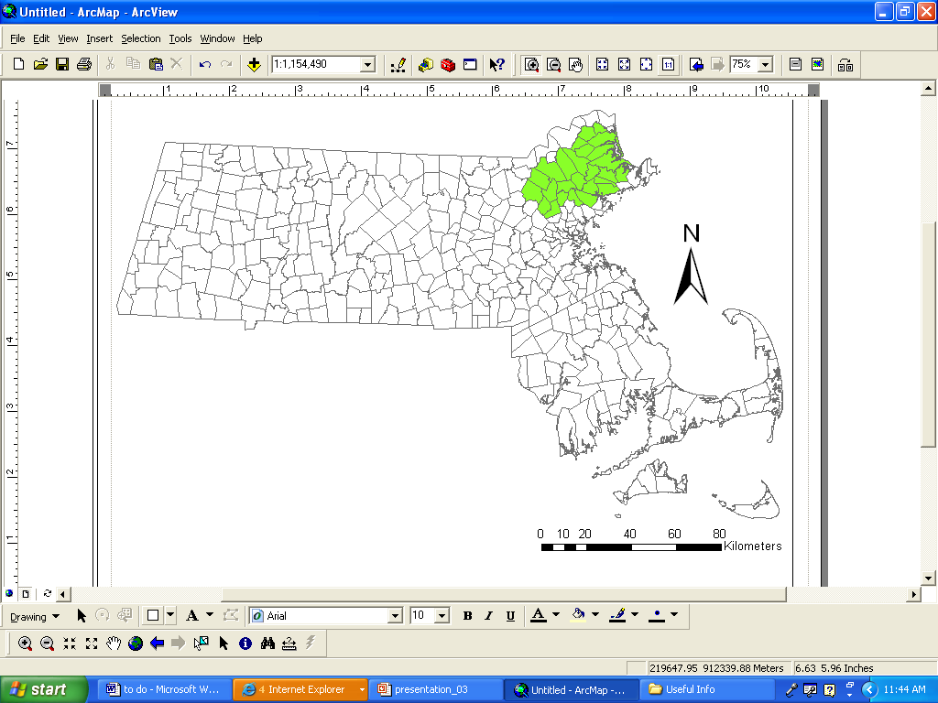


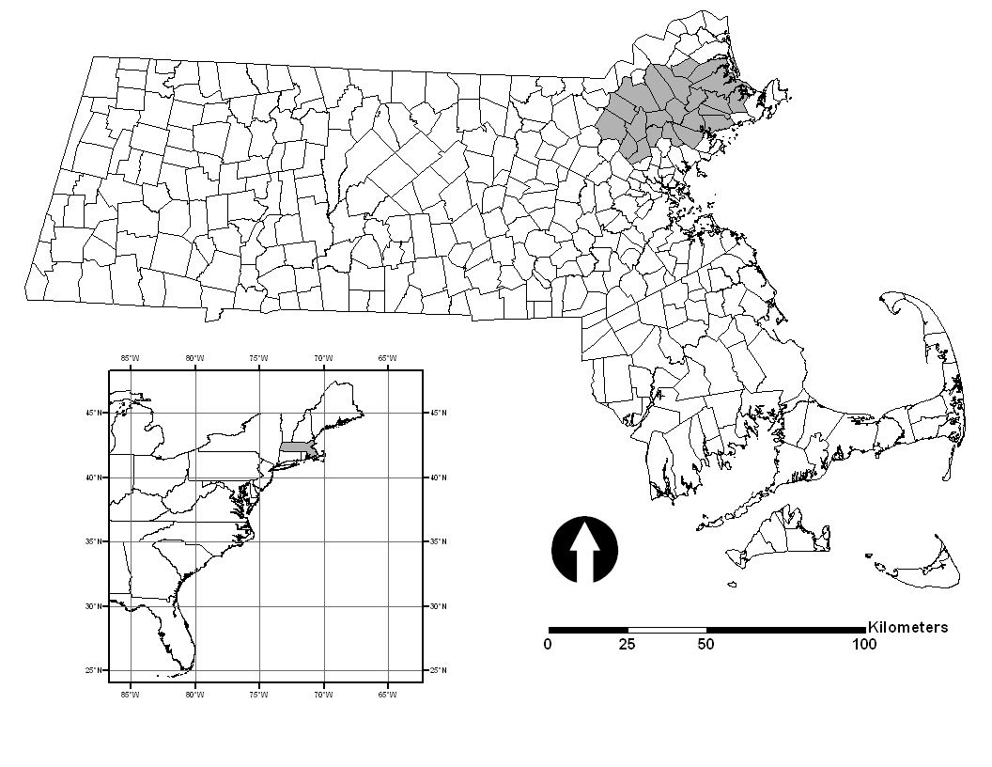

Plum Island Ecosystems (PIE) in northeastern Massachusetts

Slide 12


Slide 13
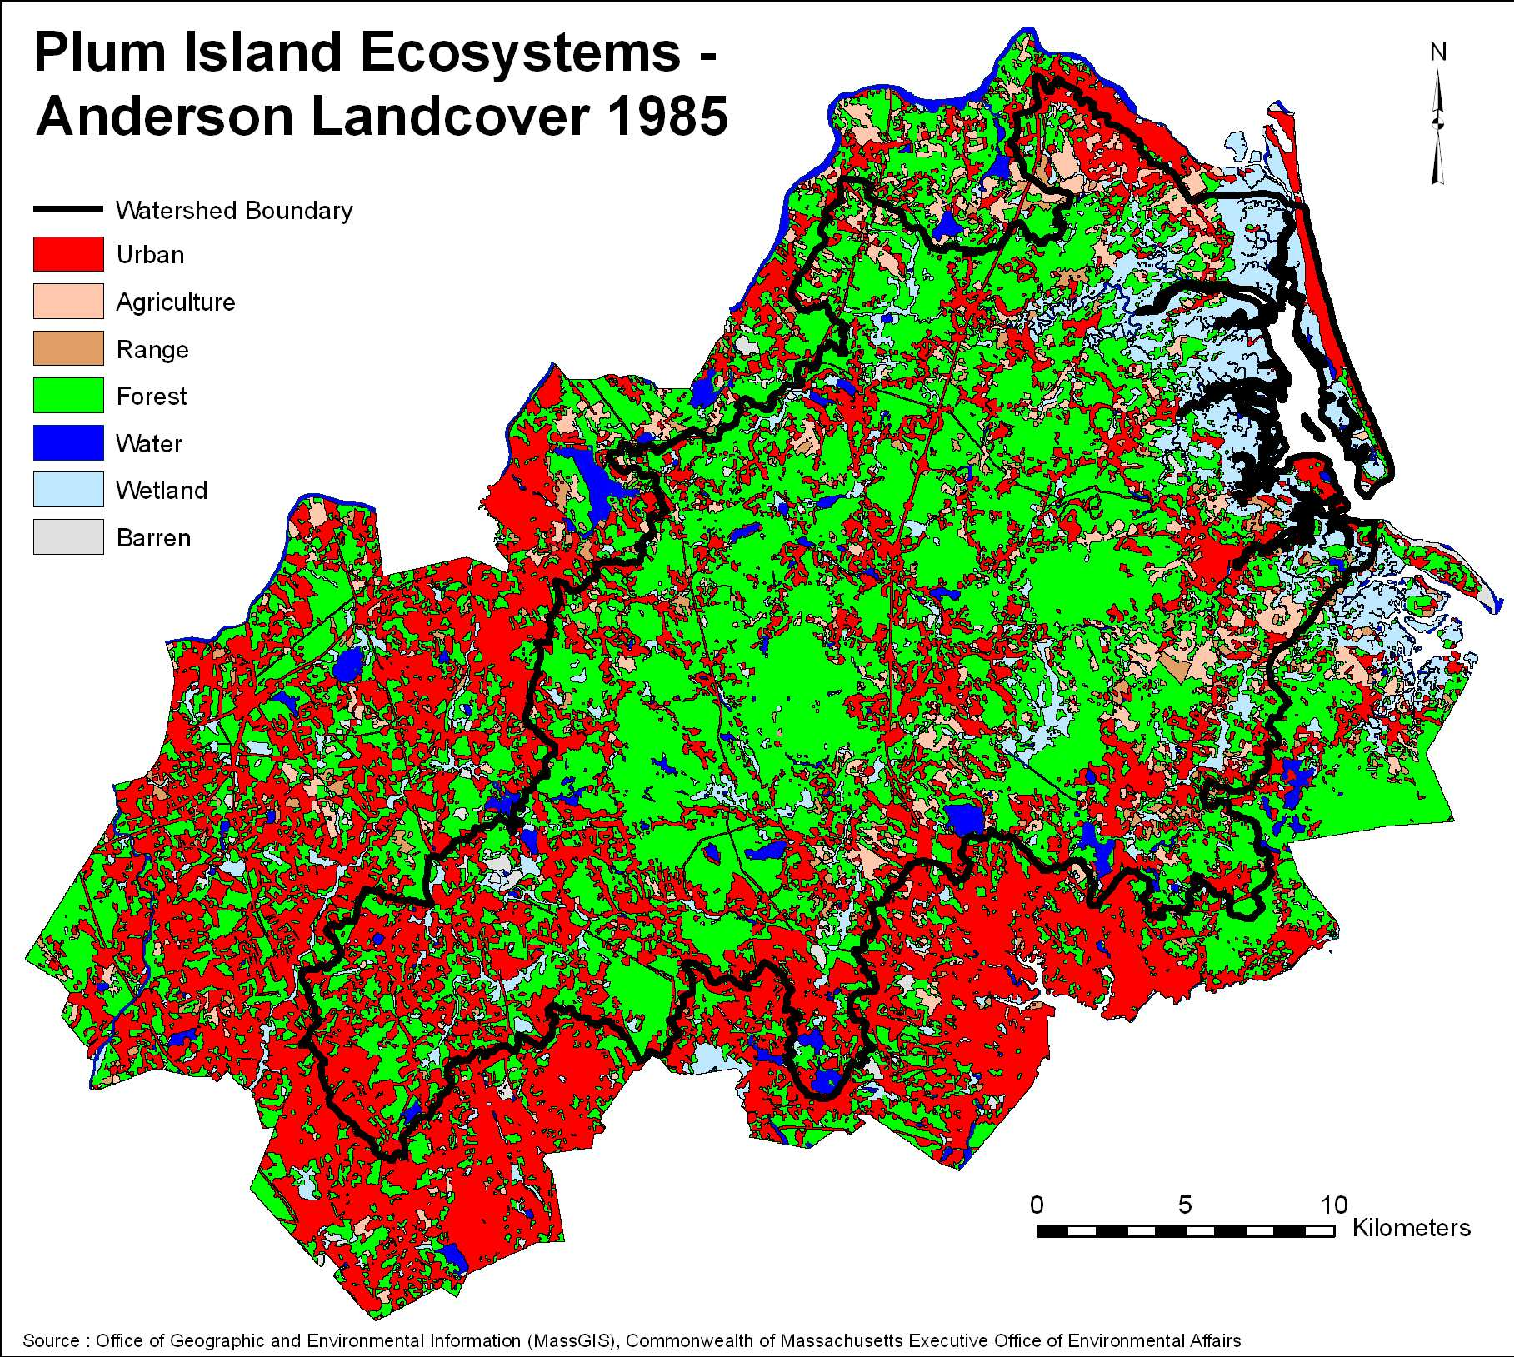

Slide 14
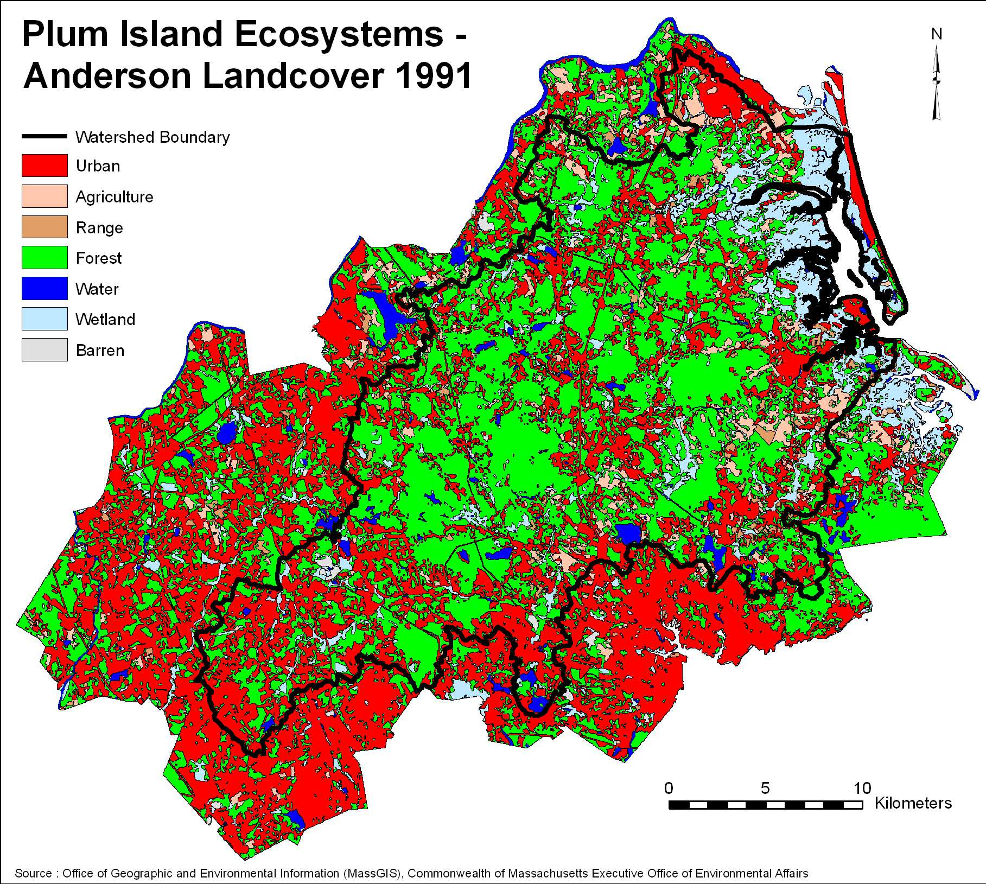

Slide 15
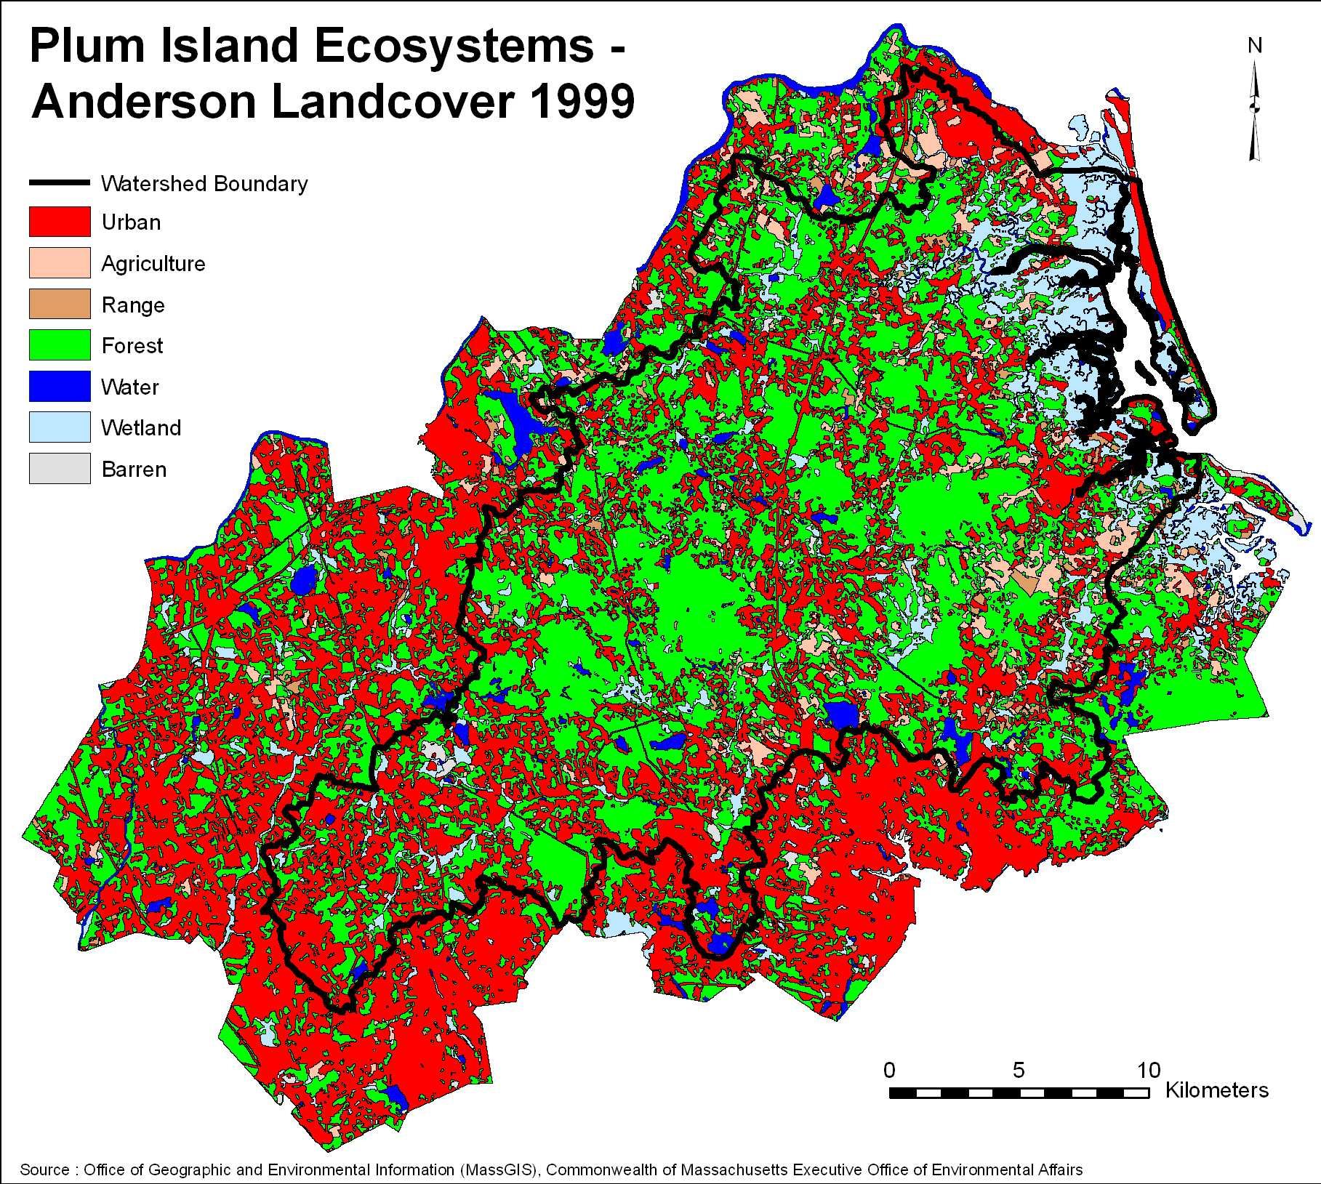

Slide 16
Topsfield, Hamilton, and Wenham

Slide 17
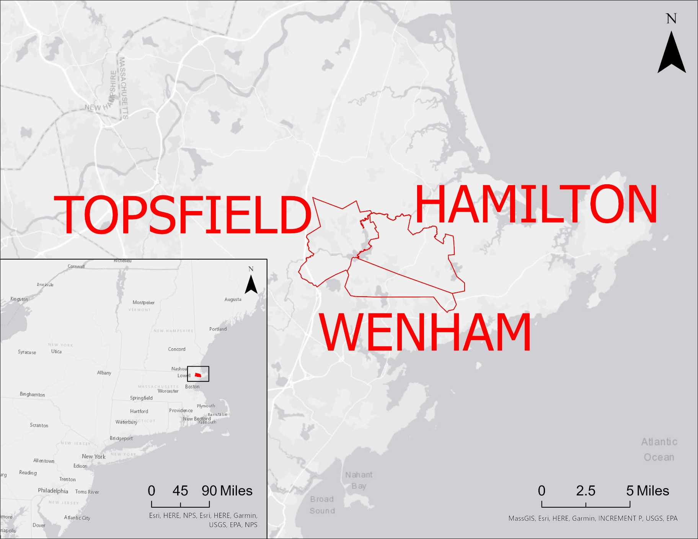
Who is from this region?

Slide 18
Topsfield, Hamilton, and Wenham

Slide 19
Topsfield, Hamilton, and Wenham

Slide 20
Topsfield, Hamilton, and Wenham

Slide 21
Topsfield, Hamilton, and Wenham

Slide 22
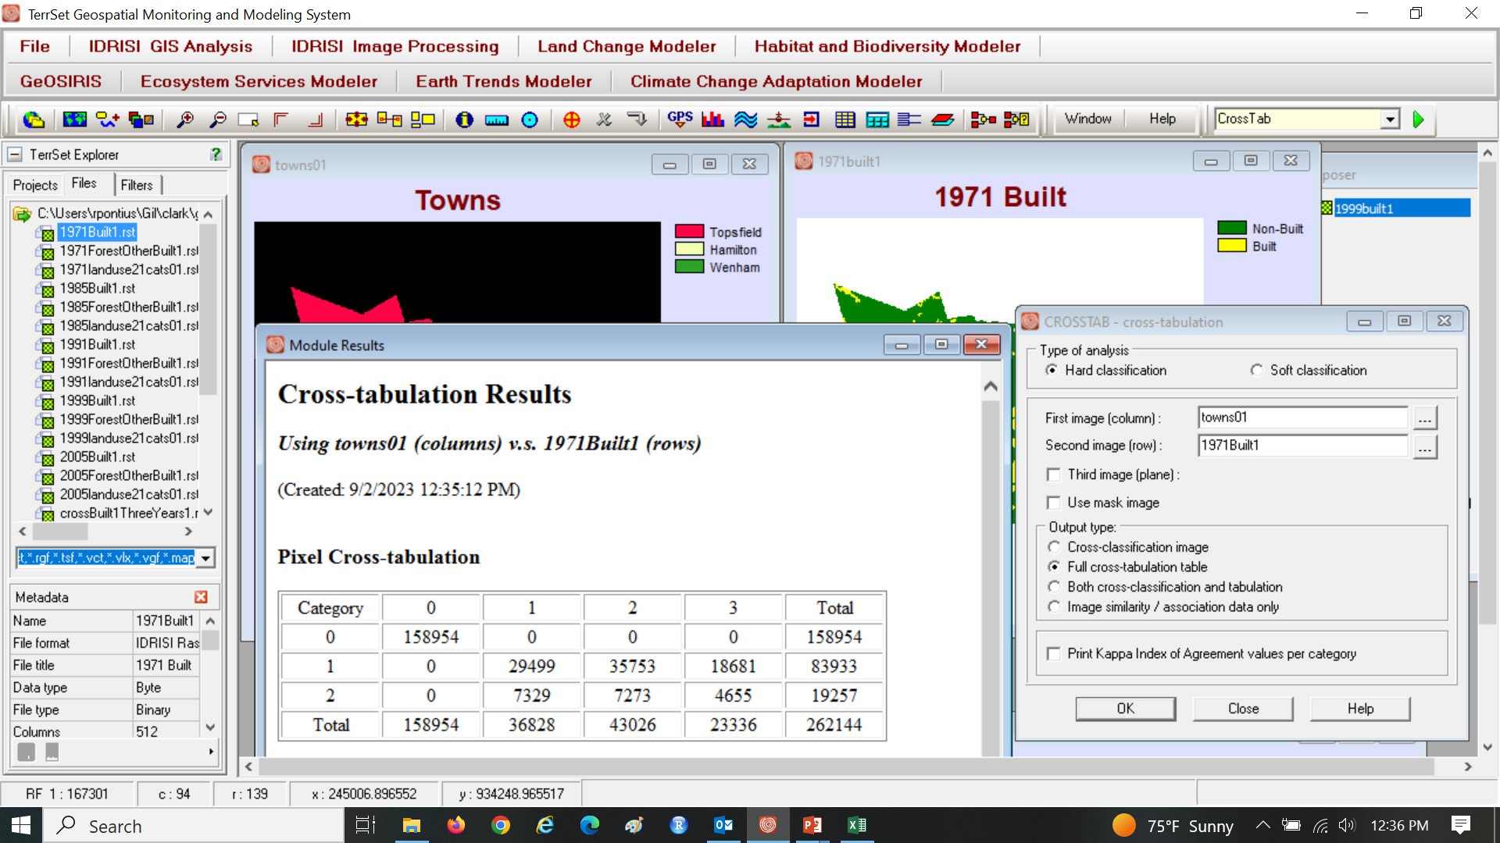
CROSSTAB with 1971Built1 as rows & Towns01 as columns.

Slide 23

CROSSTAB with 1985Built1 as rows & Towns01 as columns.

Slide 24
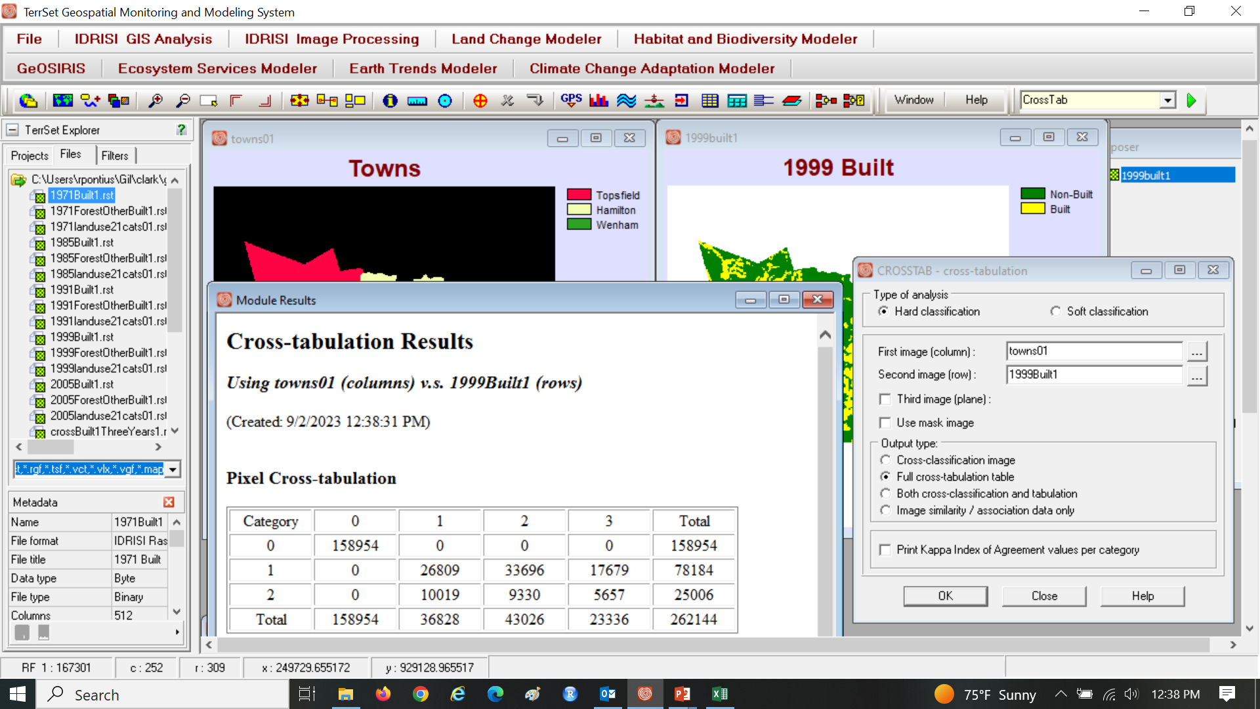
CROSSTAB with 1999Built1 as rows & Towns01 as columns.

Slide 25
Vocabulary
Interpolation fits a mathematical relationship through data points.
Extrapolation extends the mathematical relationship beyond the data.
A Parameter is a variable that determines how the mathematical relationship behaves.
Calibration uses data to set parameters.
Validation measures how the mathematical relationship fits data that was not used for calibration.

Slide 26
First step is to envision how a graphic will tell the story.

Slide 27
Interpolate the function through 1971 and 1985.

Slide 28
Show validation of change from 1985 to 1999.

Slide 29
Assignment 1 Instructions
Use the Excel template called GEOG260assign1userid01.xlsx and the TerrSet maps in the zip file ForestOtherBuilt2.zip under Get Materials on Canvas. Submit one Excel file with a file name that contains your clarku userid. The file must have exactly four sheets named: ReadMe, Input, Output, Figure.
The ReadMe sheet must have one Text Box that describes the file including the name(s) of the student(s) who will get a grade for the submission.
The Input sheet contains all the inputs shaded in gray cells. Enter data into cells A7, B3:B5, B7 for a town. Use Goal Seek to determine the Minimum Time in Input cell A2 when the linear model shows zero built in Output cell C2. Use Goal Seek to set Maximum time in Input cell A6, which is when the exponential model shows 100% built in Output cell D14. Save the values for all the gray cells in the Scenario Manager. Save one Scenario for each of the three towns.
The Output sheet has the numbers that are linked to the figure. Insert equations into cells D7:D14 to extrapolate according to an exponential and logistic equations that are interpolated through the years 1971 and 1985. Insert equations into cells D15:E15 to express the deviation between the modeled number for the year 1999 and the actual number for 1999.
The Figure sheet has only the figure. Select the block of data on the Output sheet to create a scatter plot. Right click on the figure to move it to its own sheet, which you must name Figure. Show the raw data and the three mathematical functions. Assure the chart shows excellence in graphics that the professor mentions in class. This means at the minimum that the chart has labels on the axes, a legend, legible font, no extraneous features. Set the vertical axis to begin at 0.

Slide 30
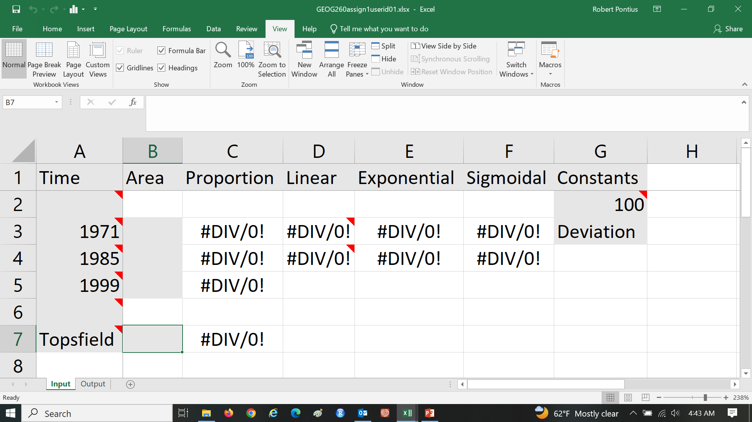
Assignment 1 Begin with the template Gray cells contain the inputs, which feed into equations to generate all other information in white cells.

Slide 31
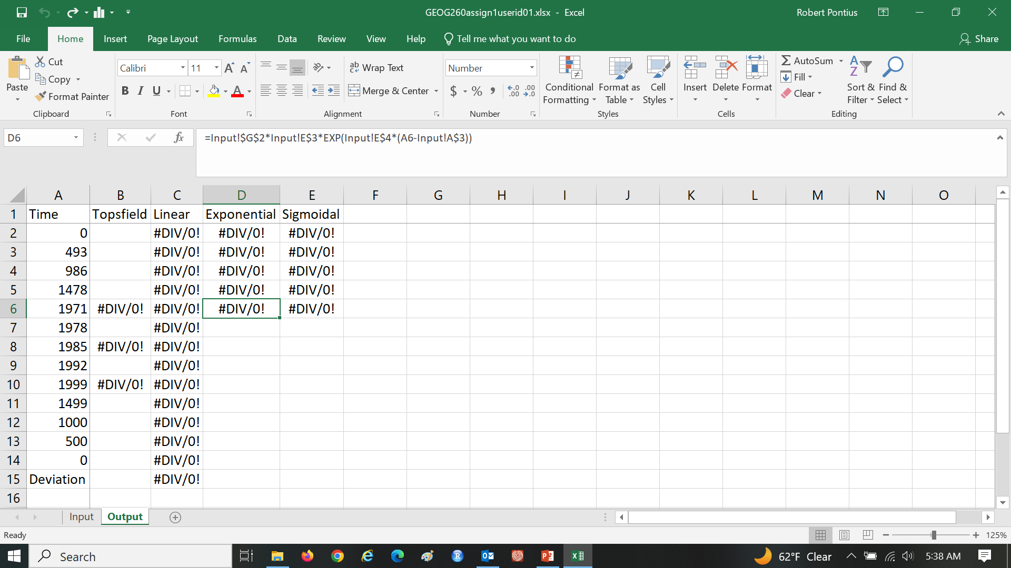
Assignment 1 Output sheet has white cells, which indicates that the numbers derive from the inputs. Output sheet will be link to the scatter plot that you create.

Slide 32
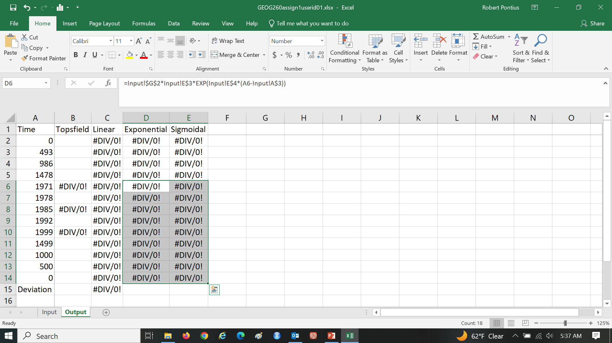
Assignment 1 Copy equations from cells D6:E6 to D7:E14.

Slide 33
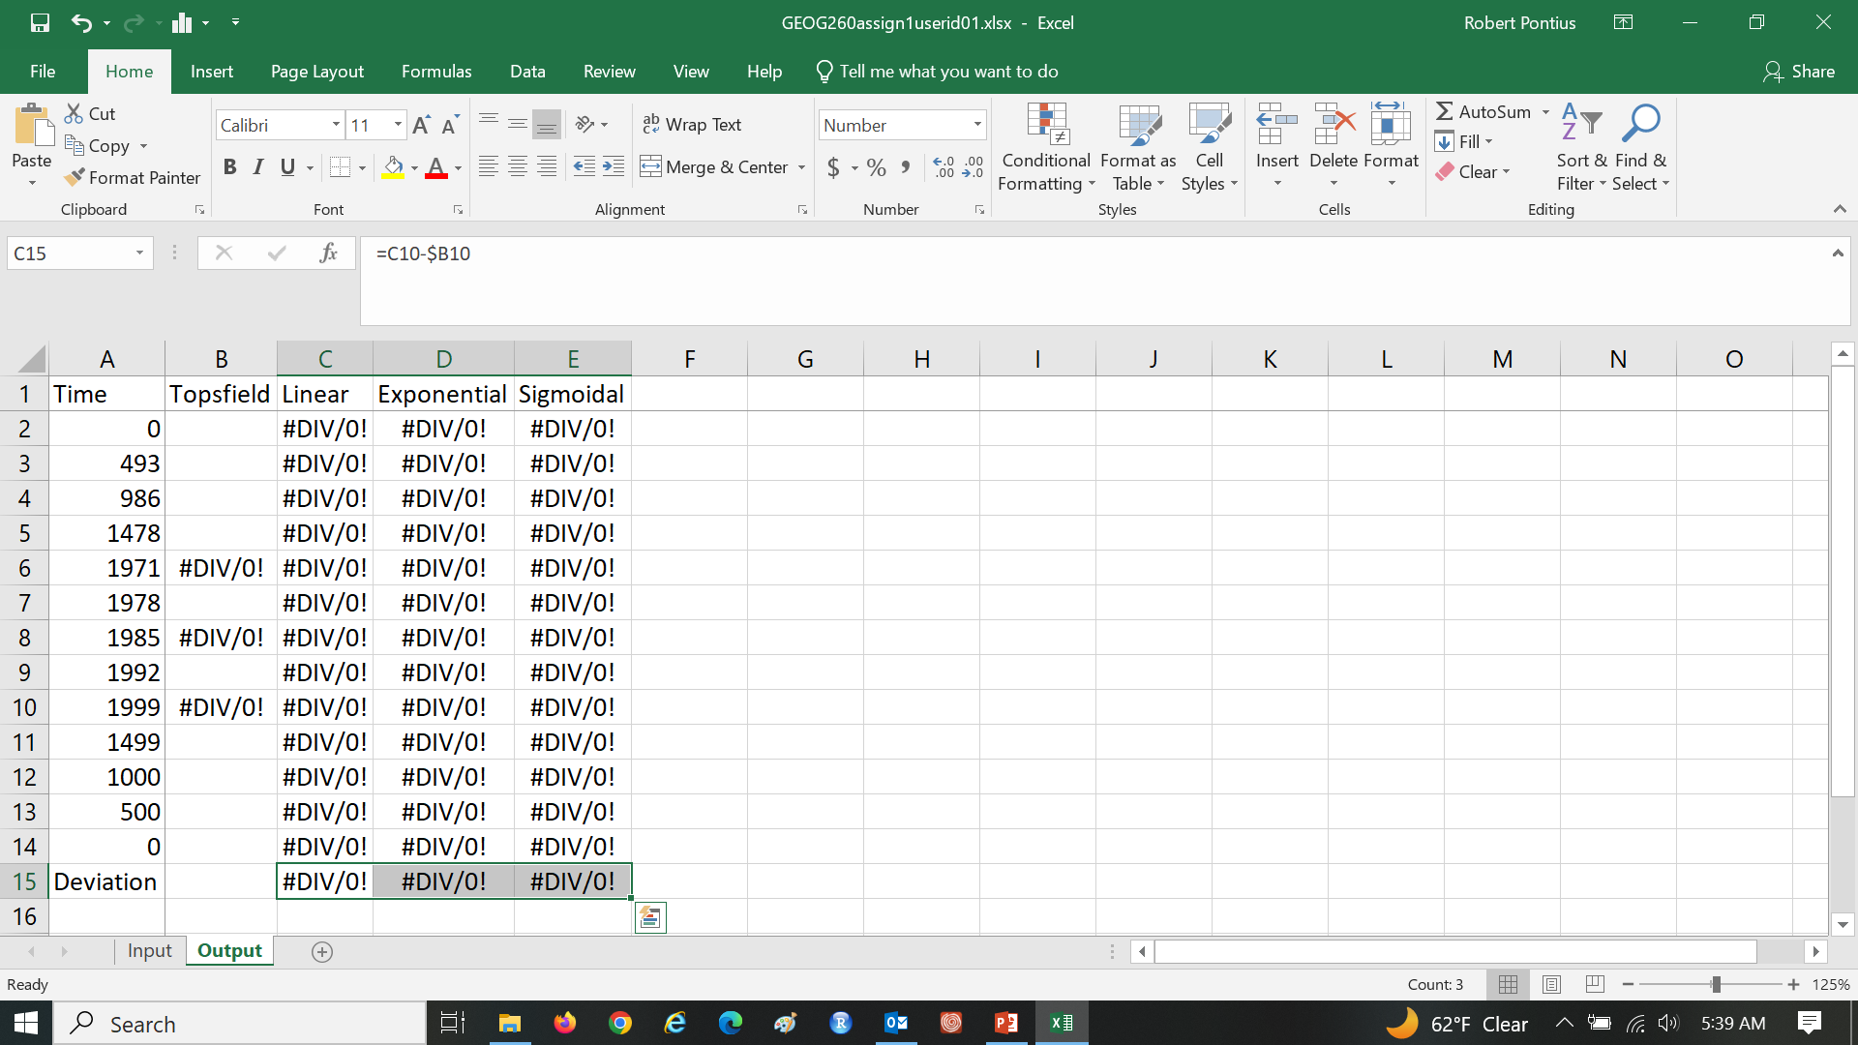
Assignment 1 Copy equations from cell C15 to cells D15:E15.

Slide 34
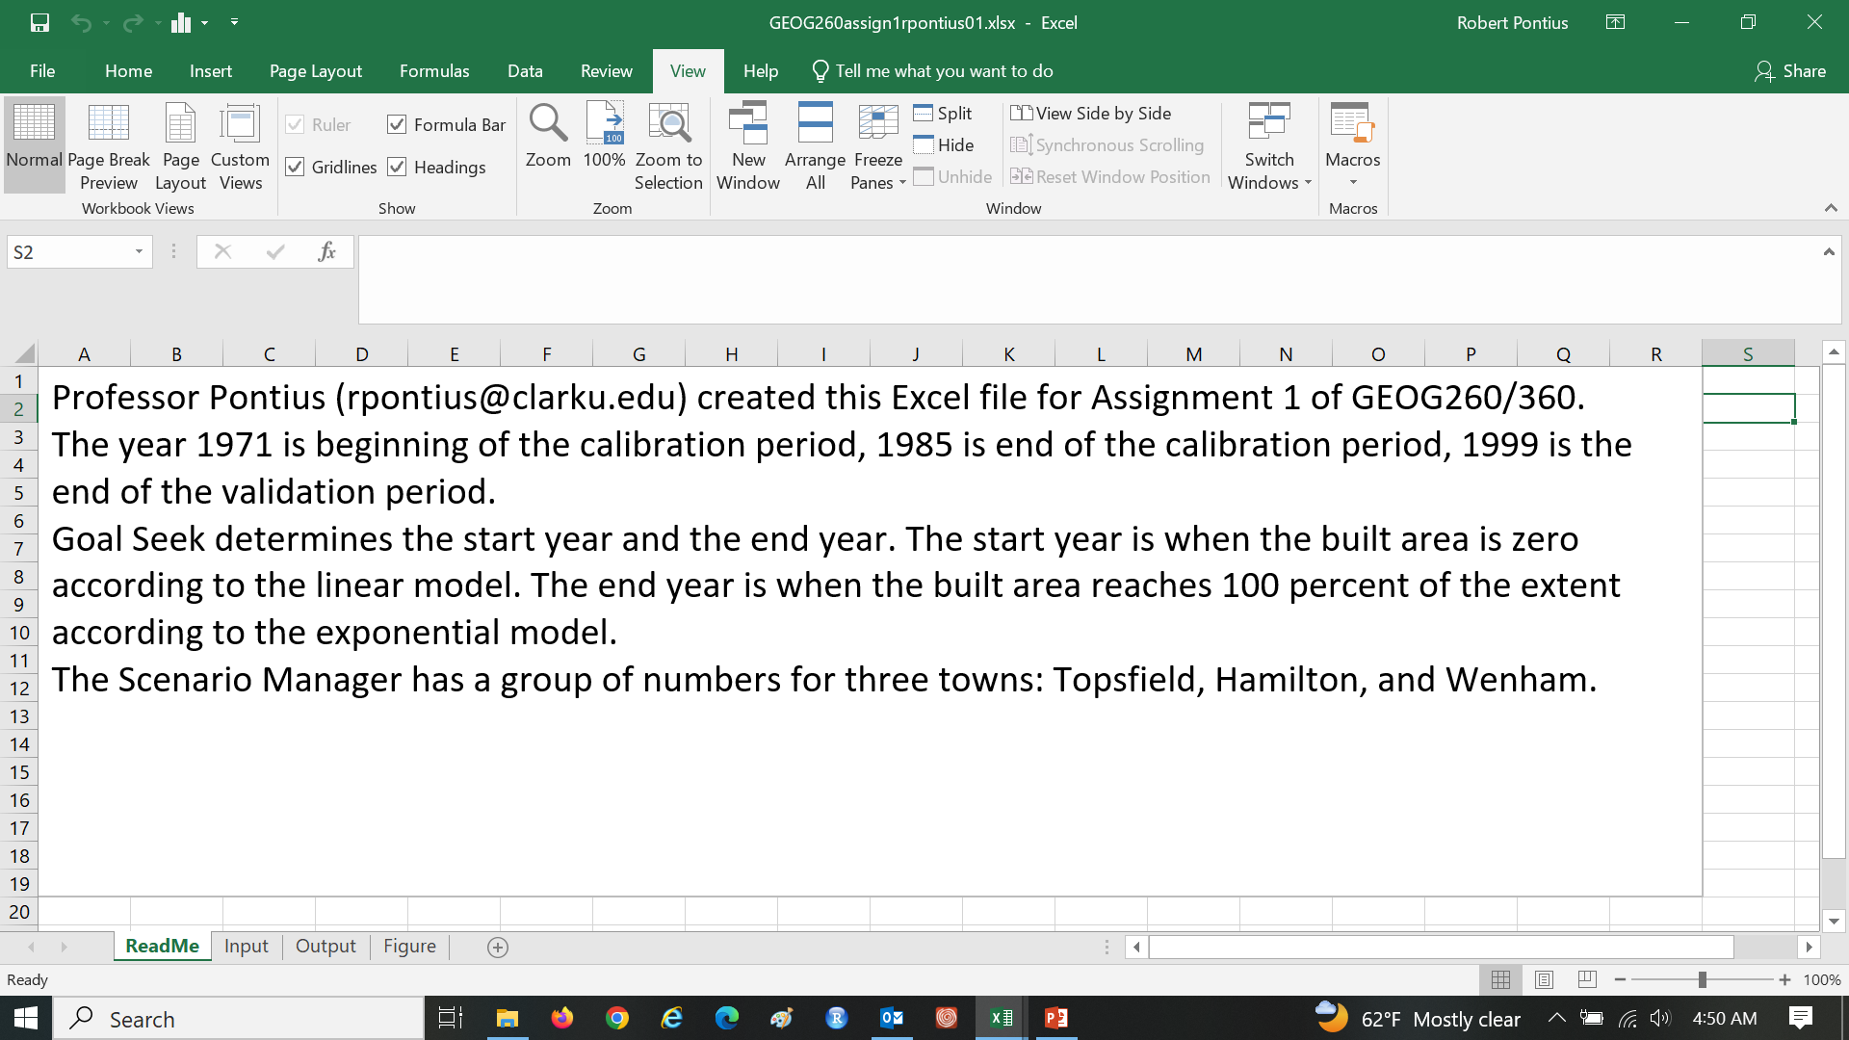
Assignment 1 Insert a ReadMe sheet, which must have one Text Box that describes the file including the name(s) of the student(s) who will get a grade for the submission.

Slide 35
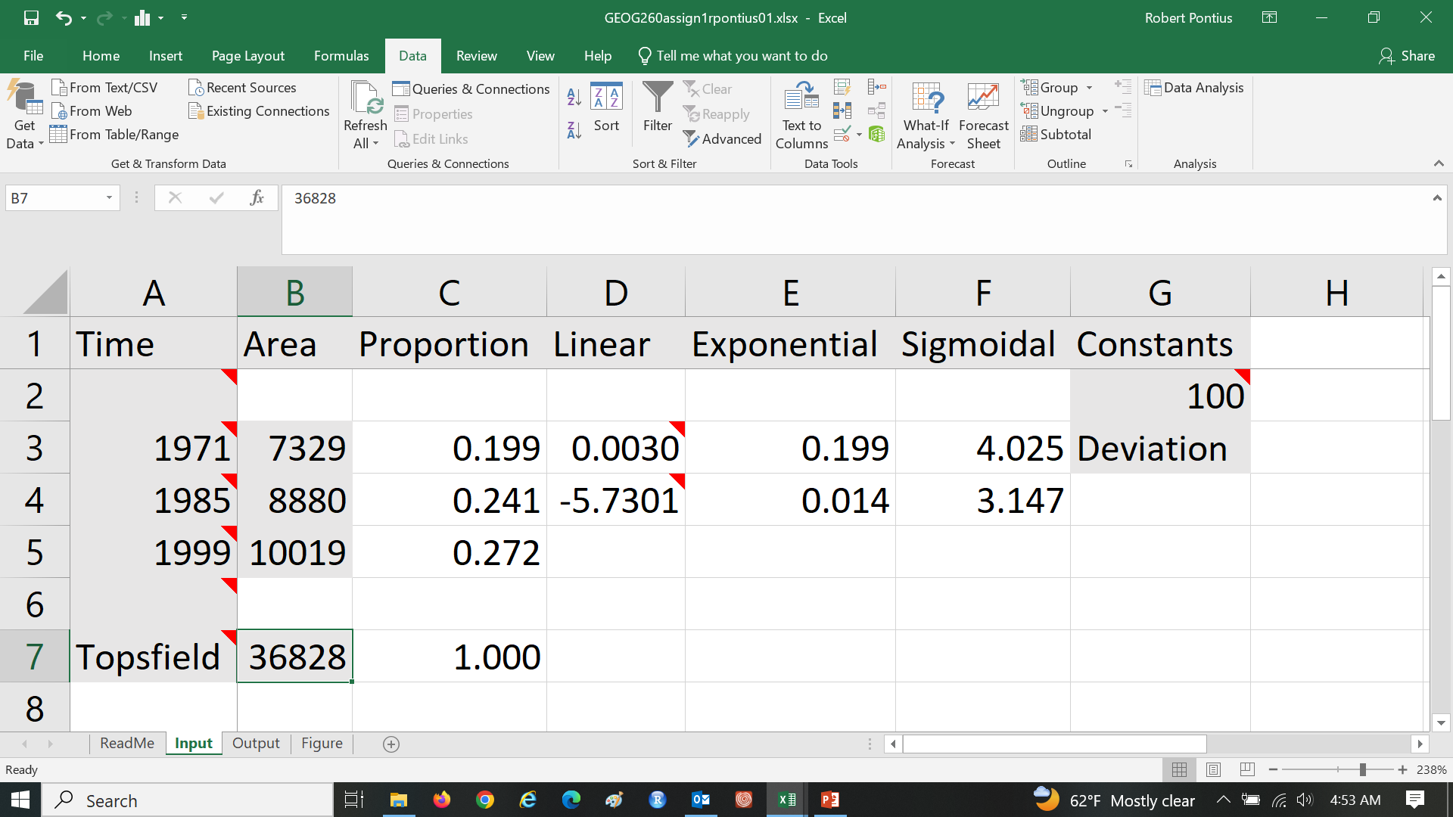
Assignment 1 Enter data into cells A7, B3:B5, B7 for a town. Equations in columns C:F compute parameters to interpolate each function through years 1971 and 1985.

Slide 36
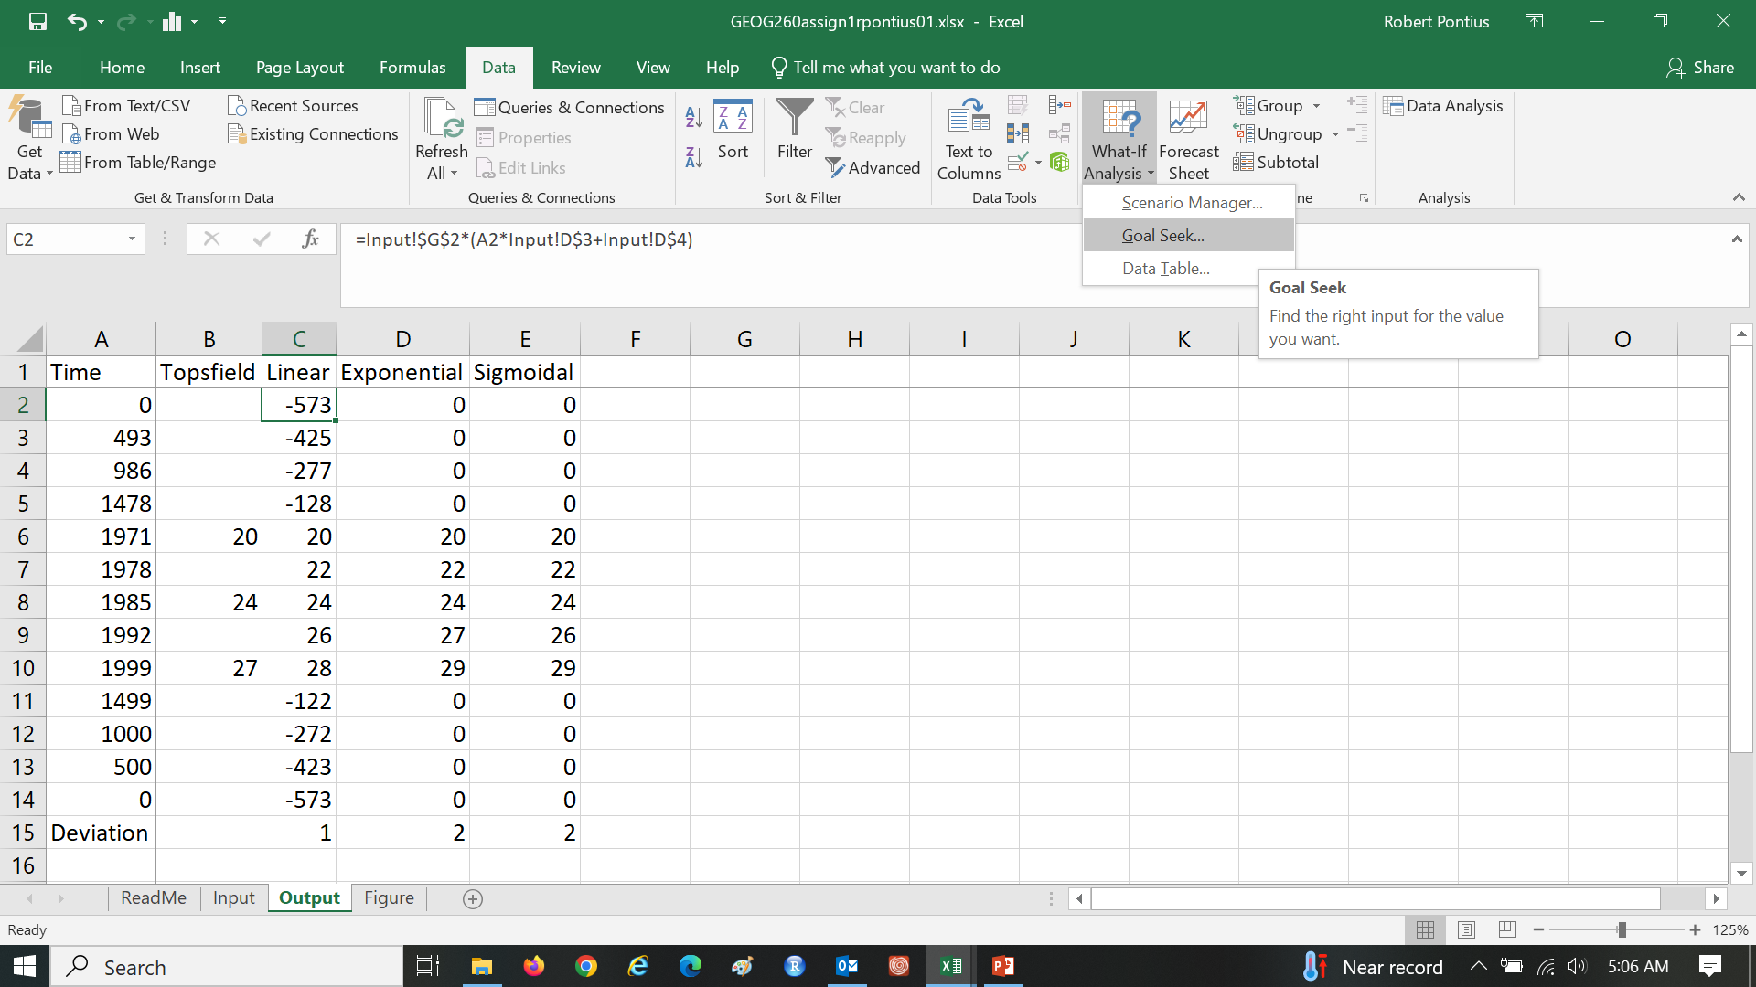
Assignment 1 Use Goal Seek to determine the Minimum Time in Input cell A2 when the linear model shows zero built in Output cell C2. Use Goal Seek to set Maximum time in Input cell A6, which is when the exponential model shows 100% built in Output cell D14.

Slide 37
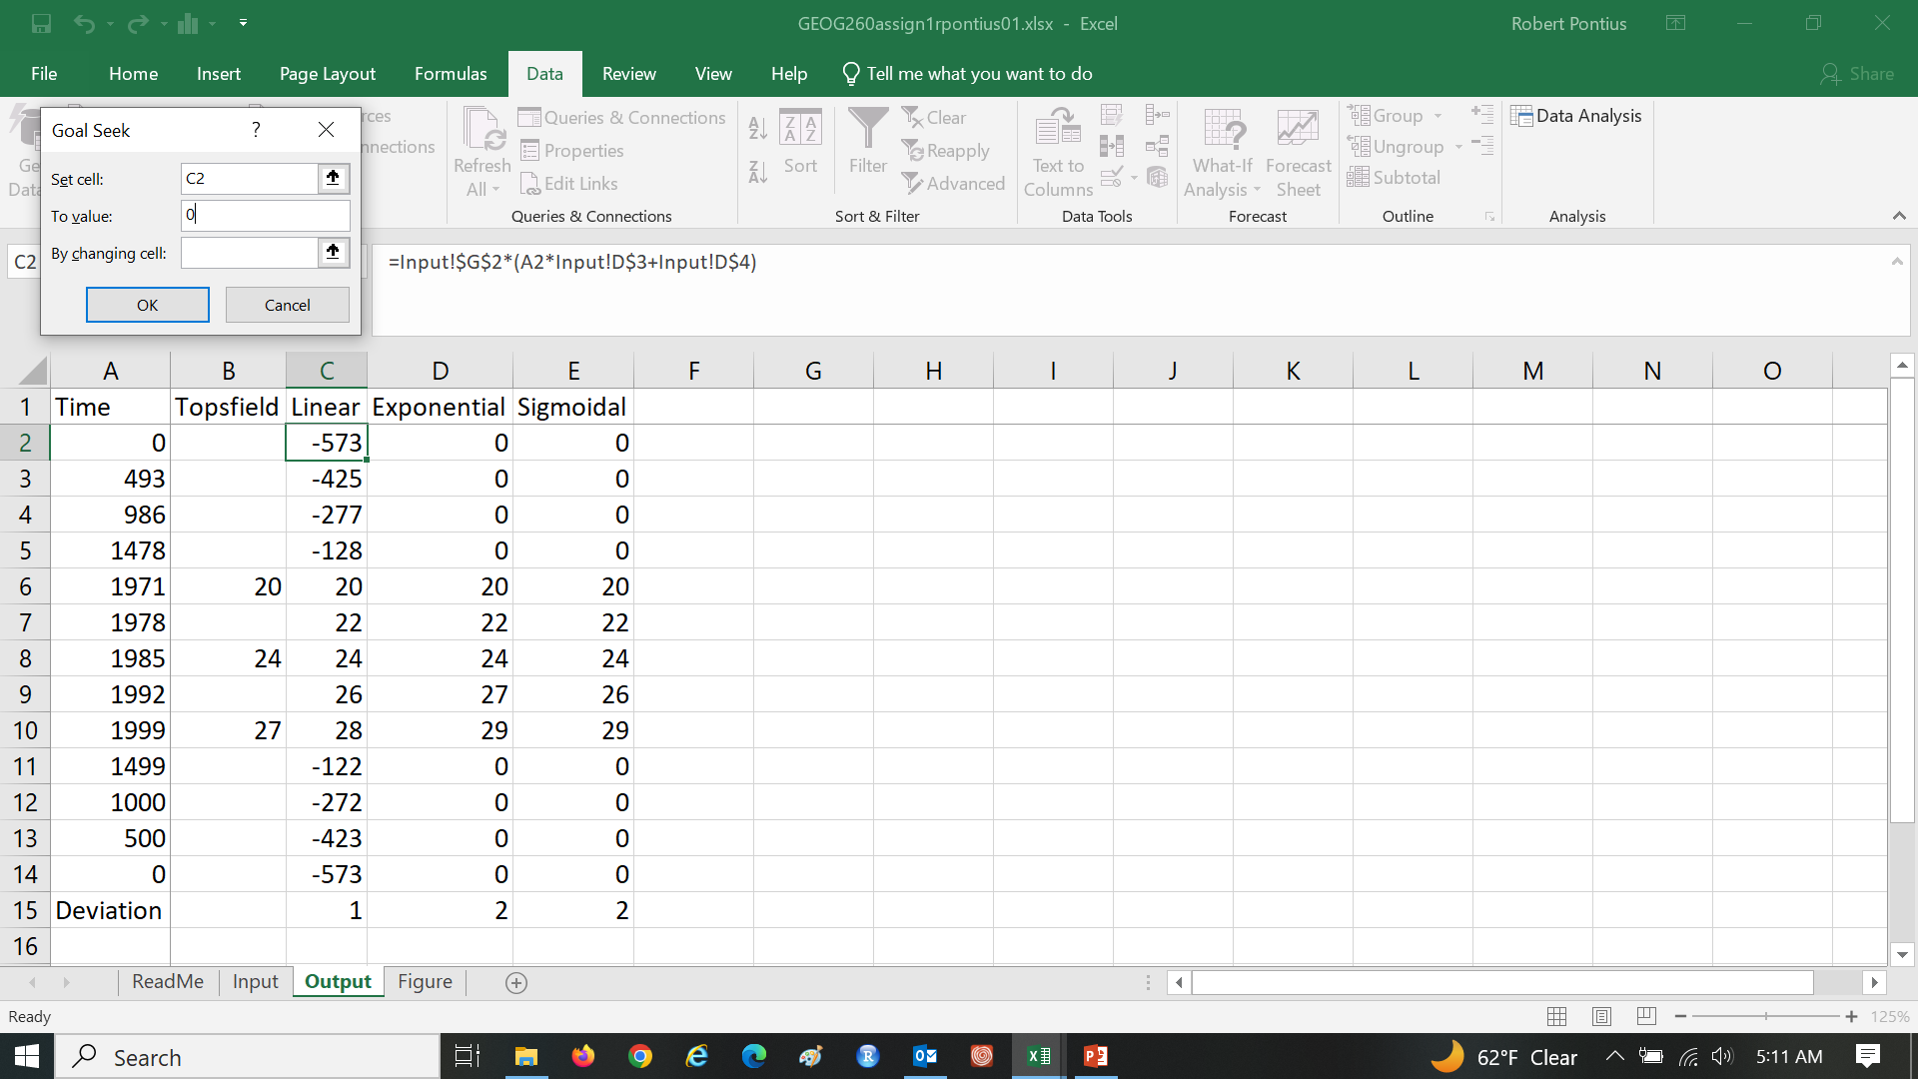
Assignment 1 Use Goal Seek to determine the Minimum Time in cell A2 when the linear model shows zero built.

Slide 38
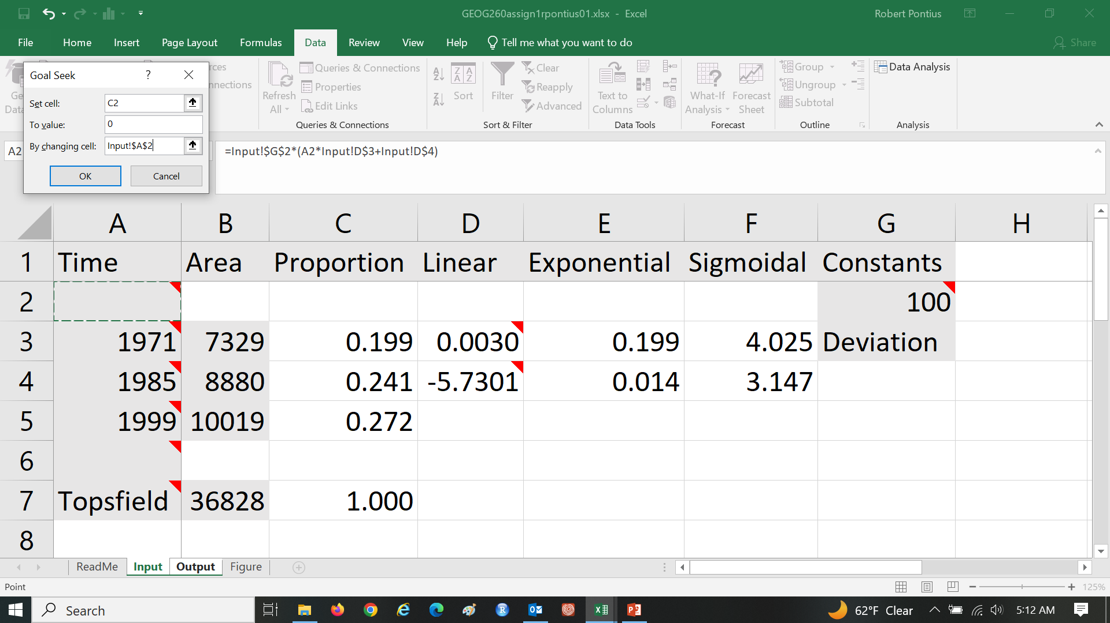
Assignment 1 Use Goal Seek to determine the Minimum Time in cell A2 when the linear model shows zero built.

Slide 39
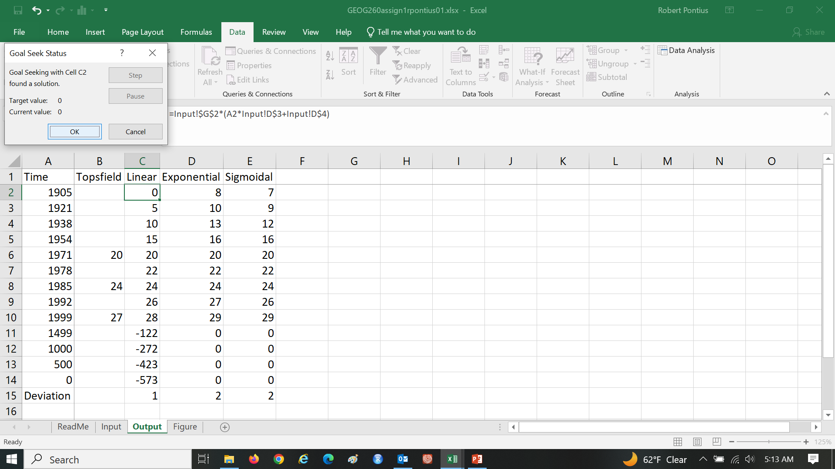
Assignment 1 Use Goal Seek to determine the Minimum Time in cell A2 when the linear model shows zero built.

Slide 40
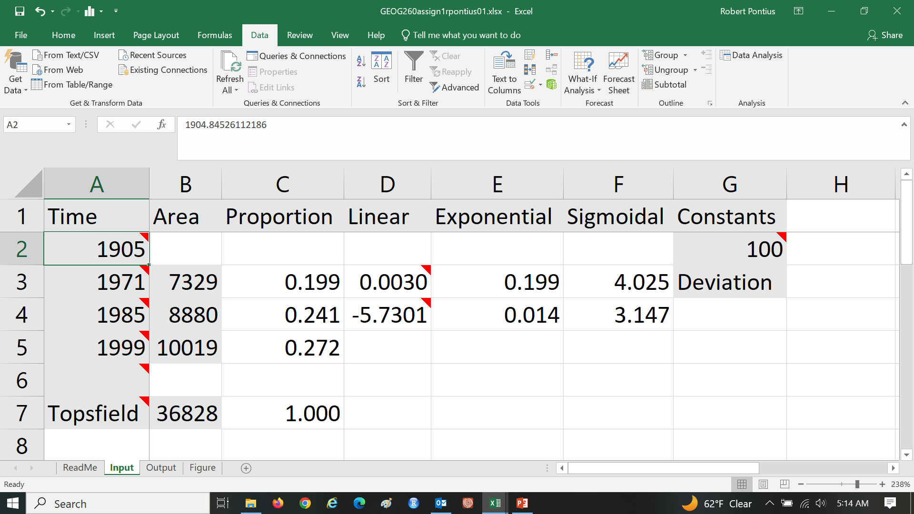
Assignment 1 The linear model extrapolated backwards in time to have zero built at the year 1904.84526112186.

Slide 41

Assignment 1 Use Goal Seek to set Maximum time, which is when the exponential model shows 100% built.

Slide 42
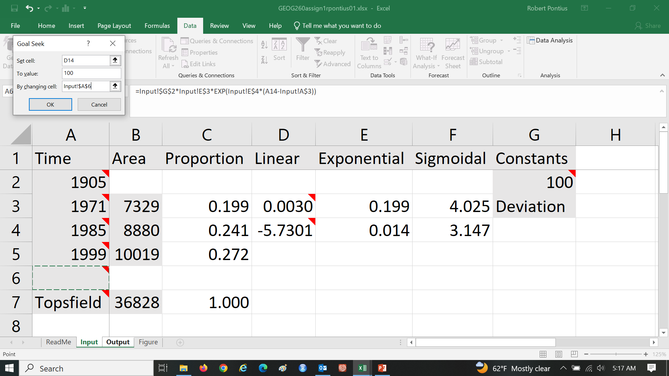
Assignment 1 Use Goal Seek to set Maximum time, which is when the exponential model shows 100% built.

Slide 43
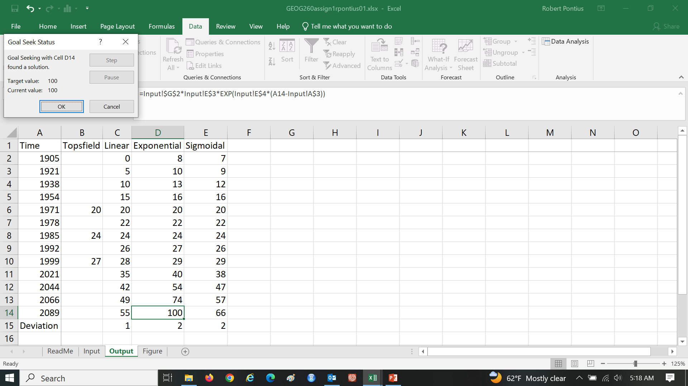
Assignment 1 Use Goal Seek to set Maximum time, which is when the exponential model shows 100% built.

Slide 44
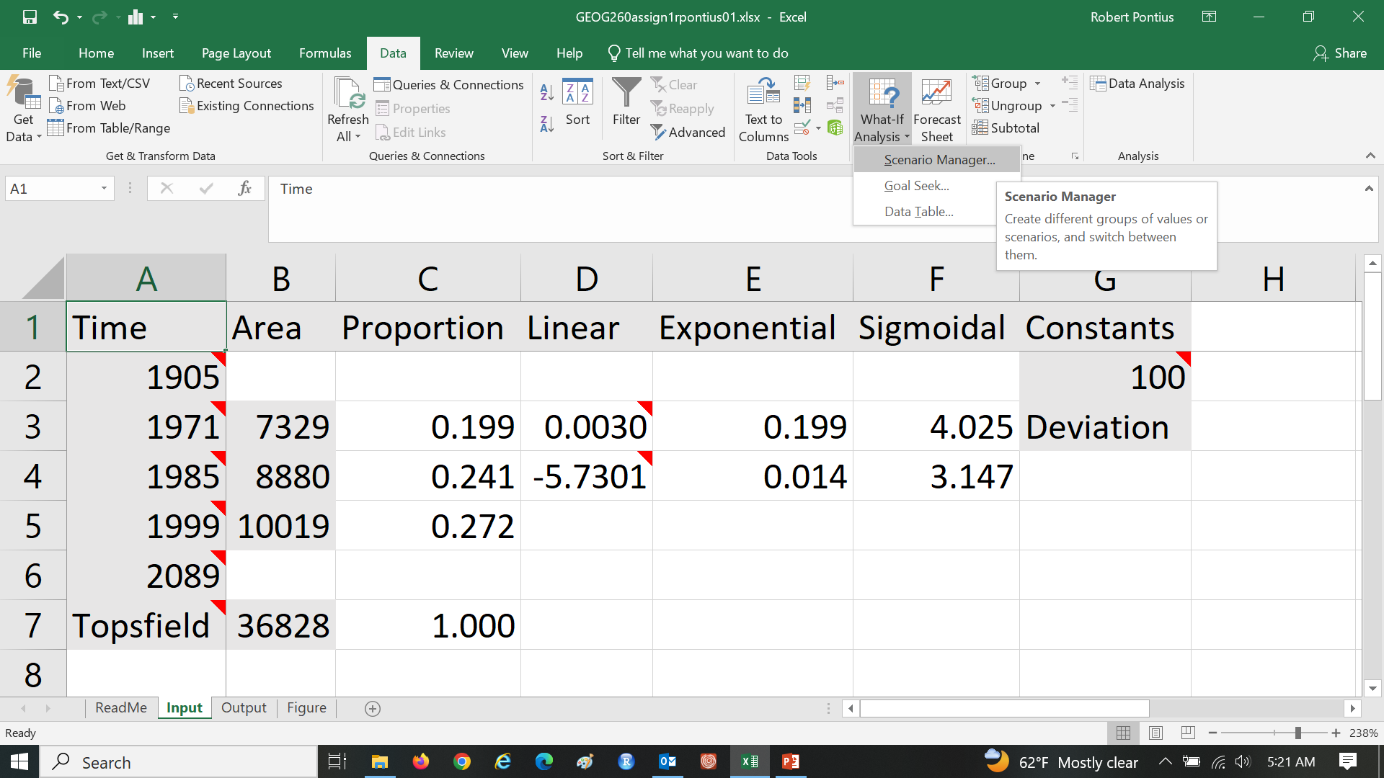
Assignment 1 Open the Scenario Manager, which you will use to save the numbers in gray cells for each of the towns. You will create one scenario for each town.

Slide 45
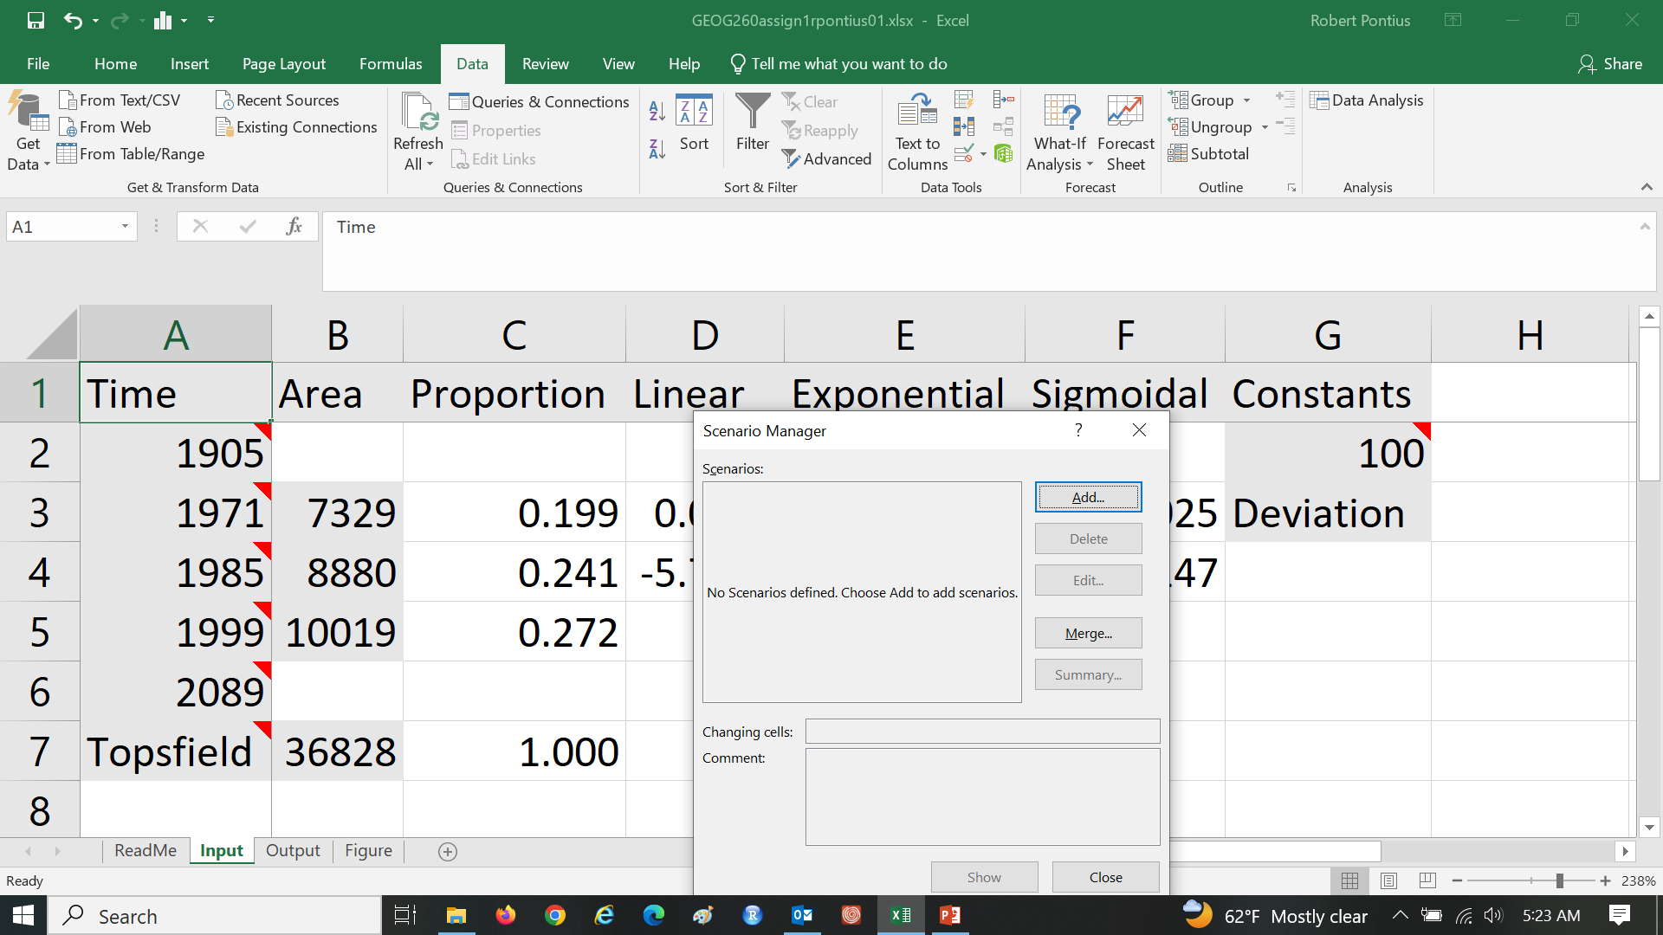
Assignment 1 Add a Scenario to have the Town name. You will create one scenario for each town.

Slide 46
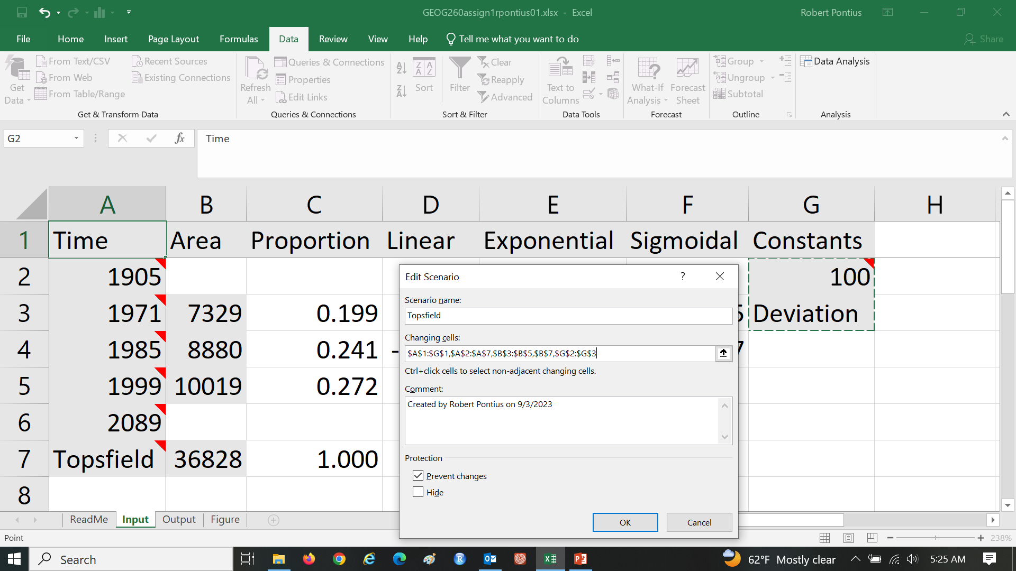
Assignment 1 Add a Scenario to have the Town name. You will create one scenario for each town.

Slide 47
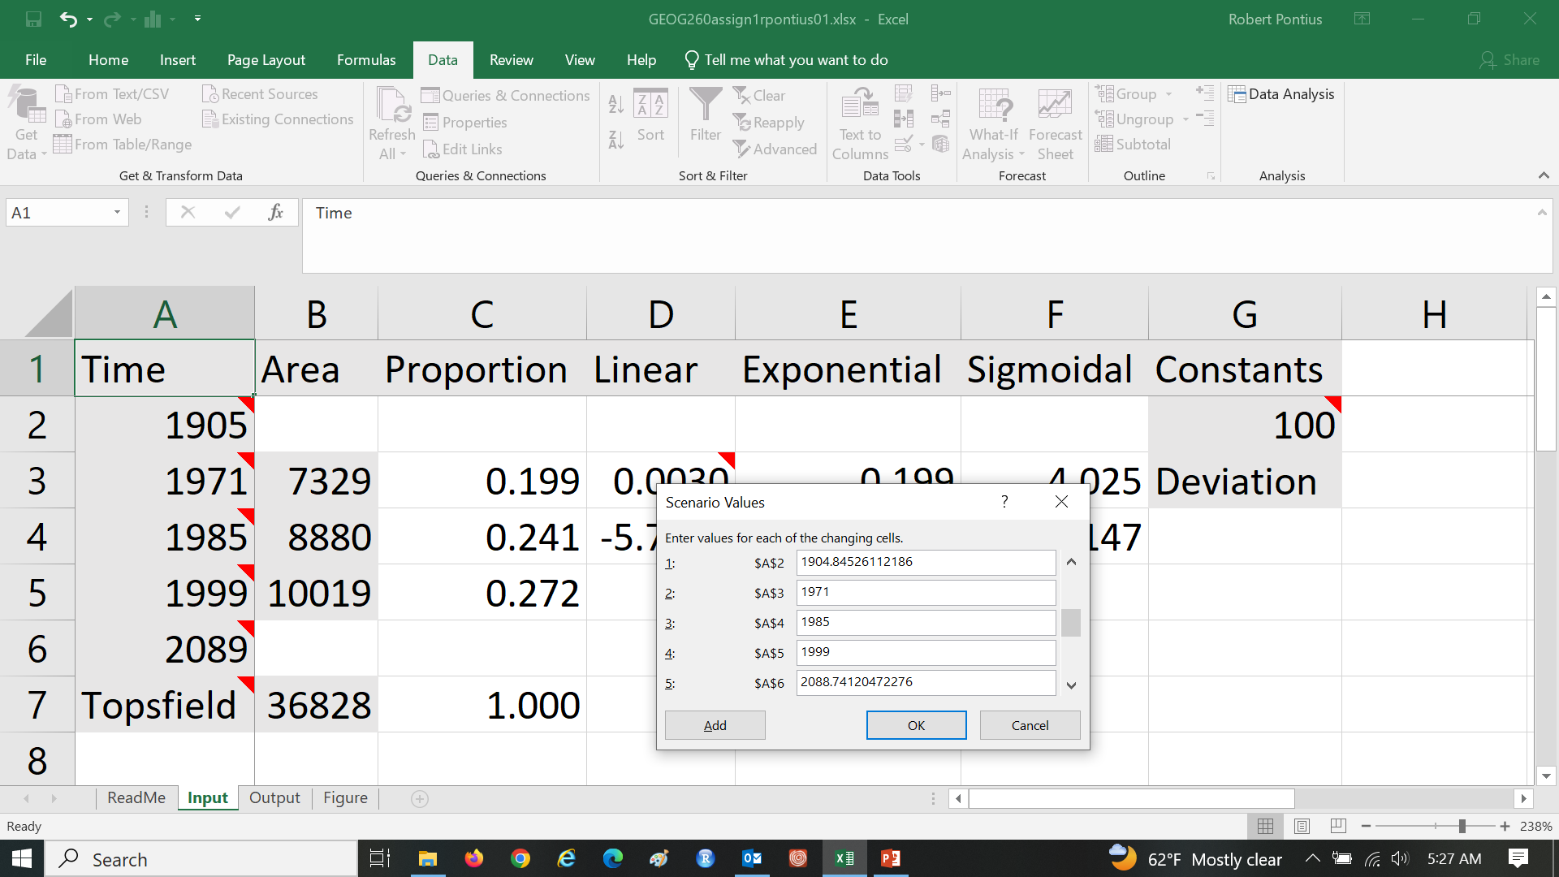
Assignment 1 Add a Scenario to have the Town name. You will create one scenario for each town.

Slide 48
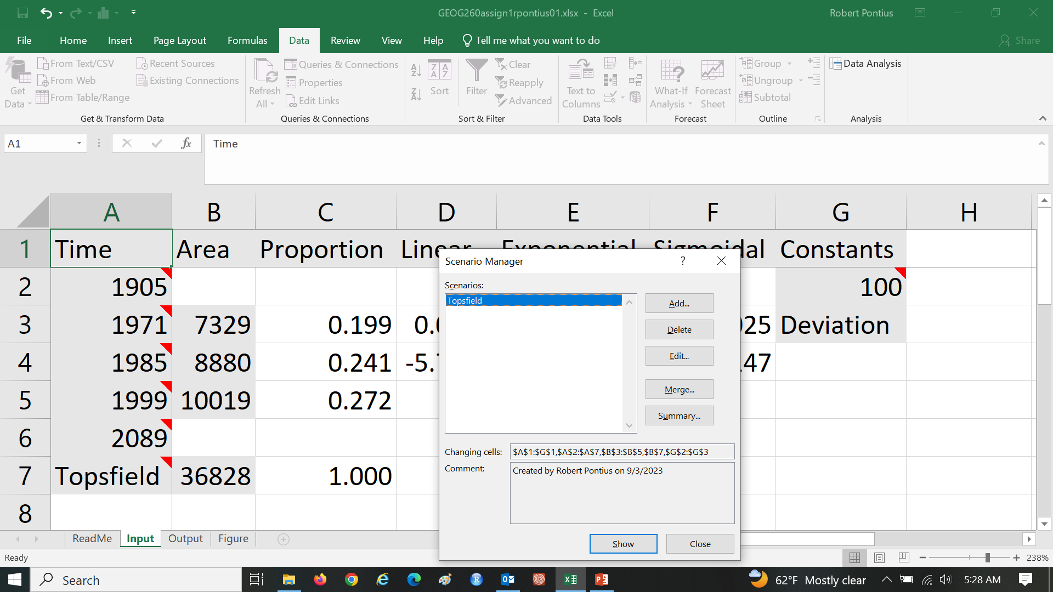
Assignment 1 Add a Scenario to have the Town name. You will create one scenario for each town.

Slide 49
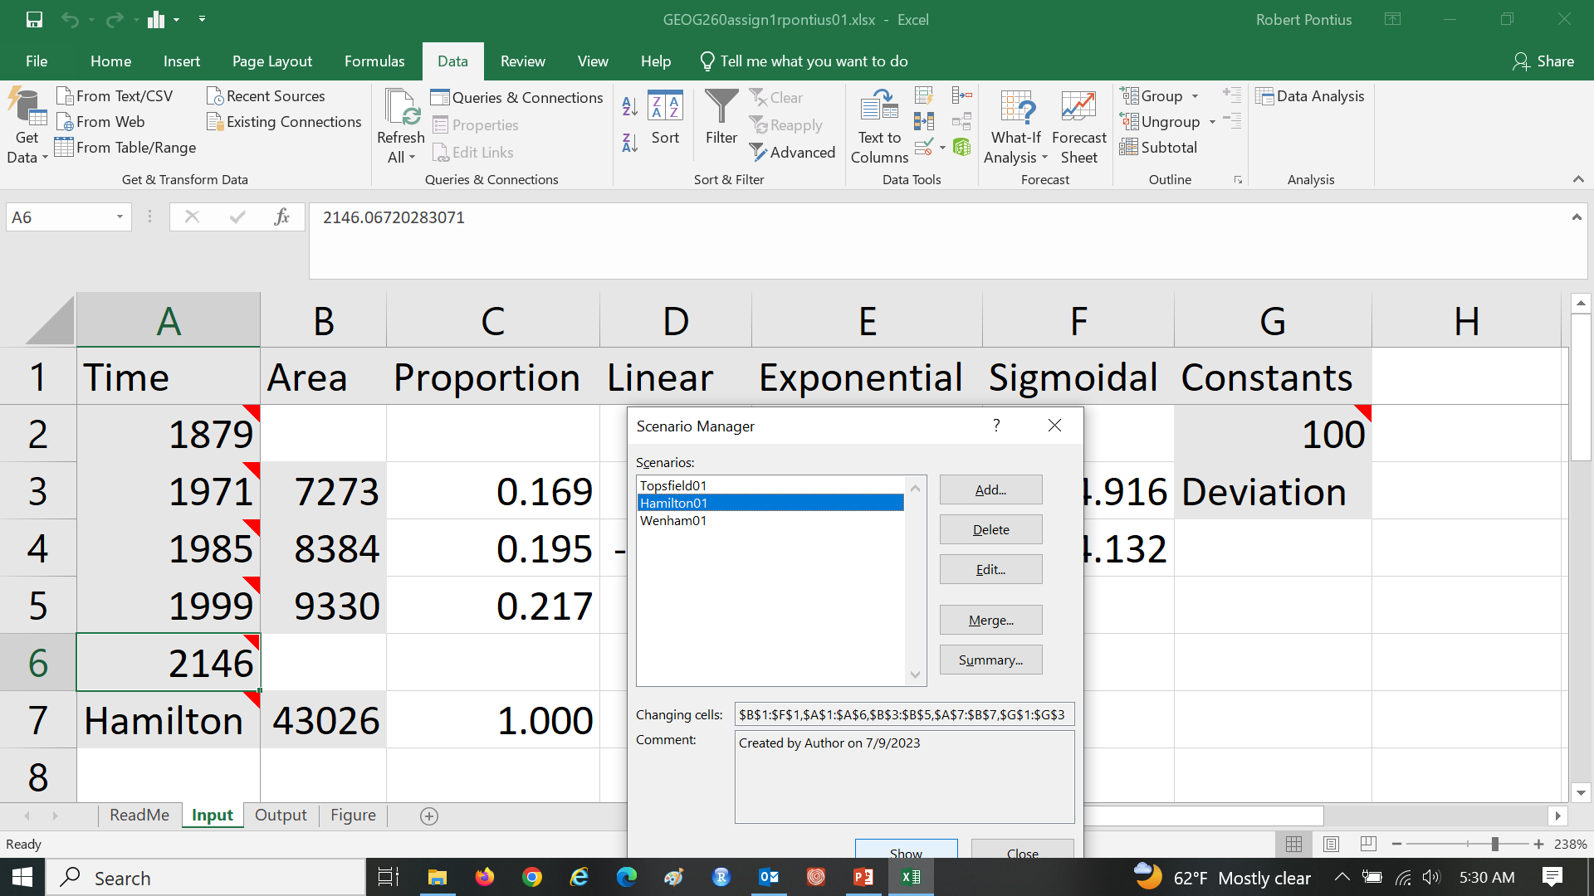
Assignment 1 Do the same for Hamilton and Wenham so you have a scenario for each town.

Slide 50
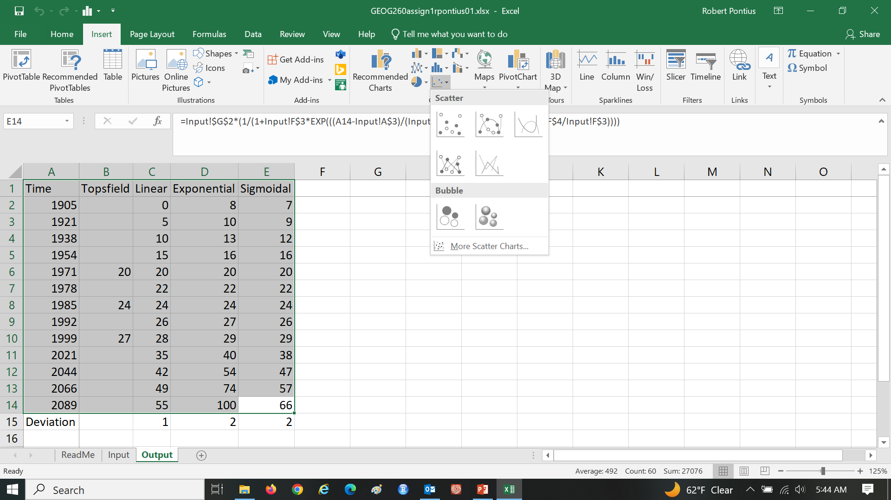
Assignment 1 Select data on Output Sheet to insert a Scatter Plot

Slide 51
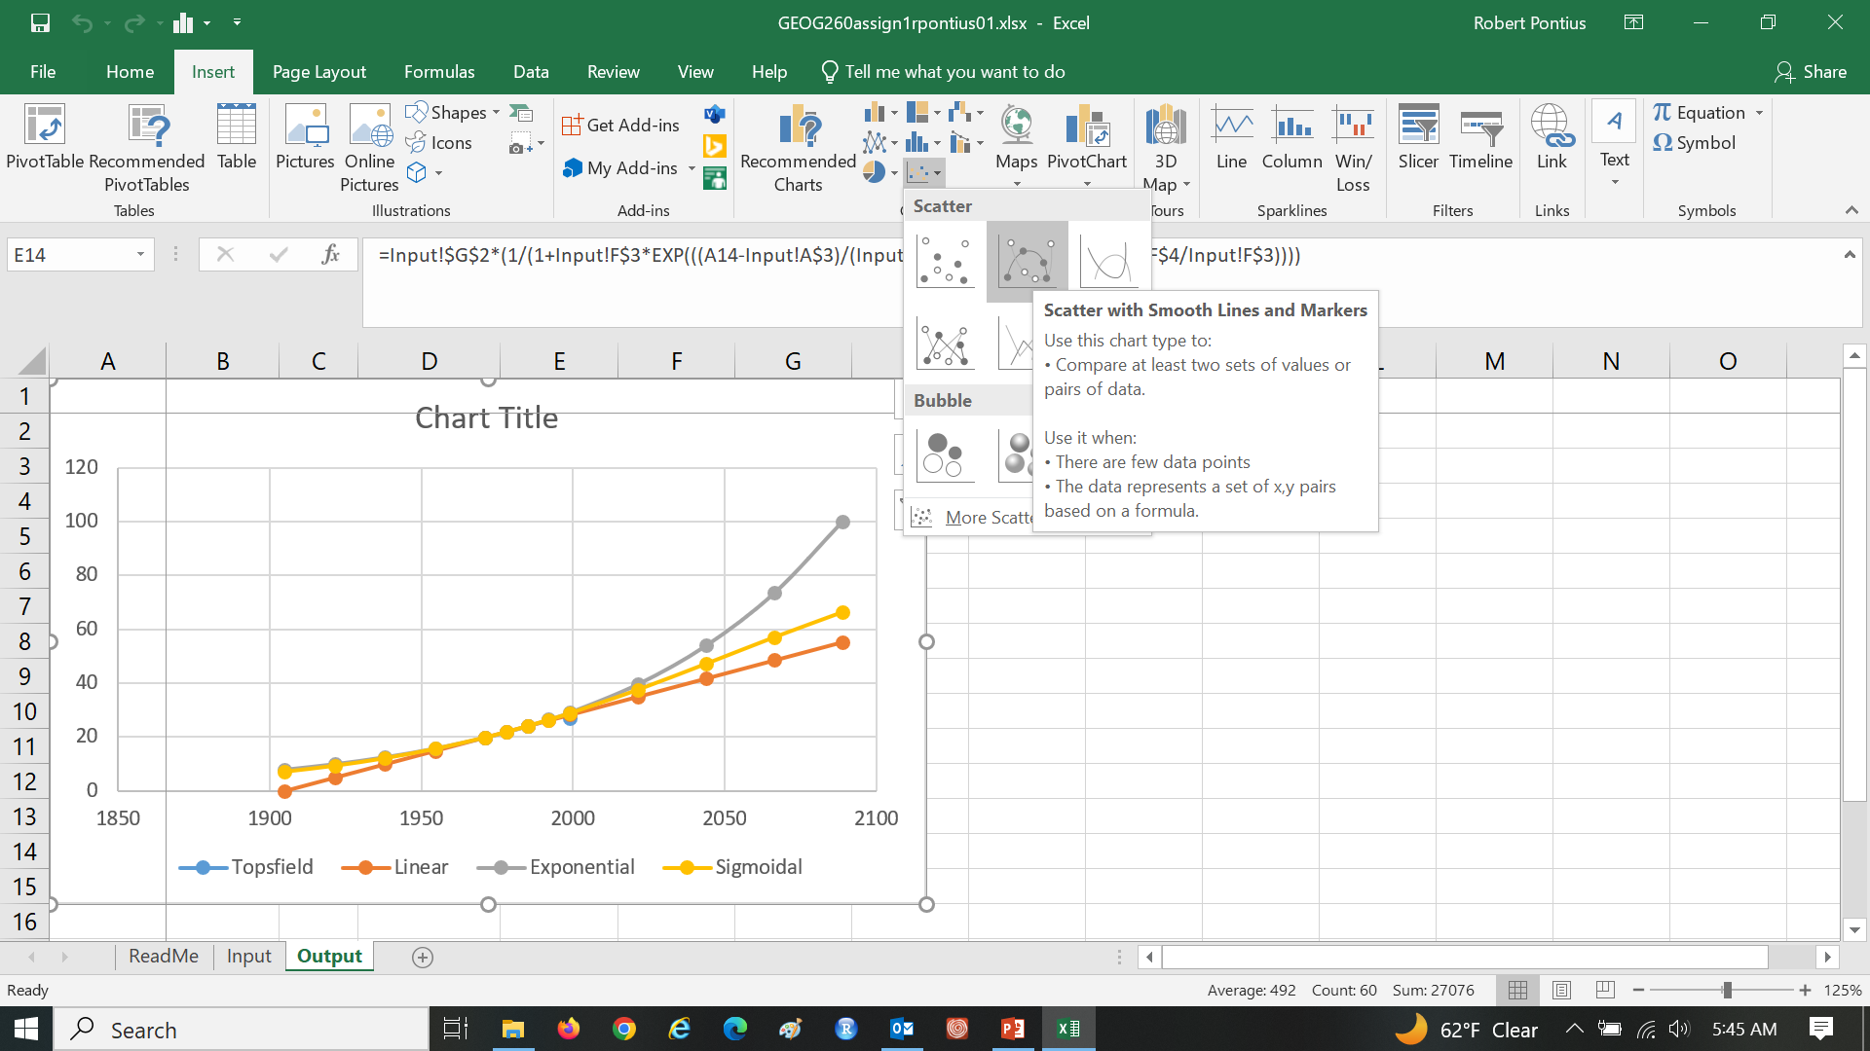
Assignment 1 Select data on Output Sheet to insert a Scatter Plot

Slide 52
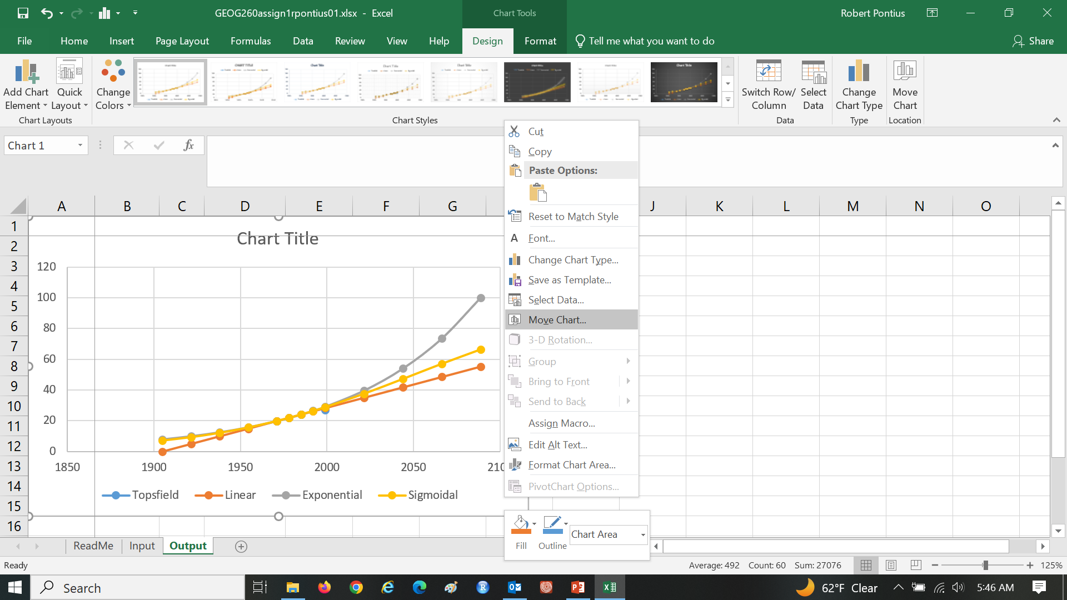
Assignment 1 Right click on Chart Area to Move Chart to a new sheet

Slide 53
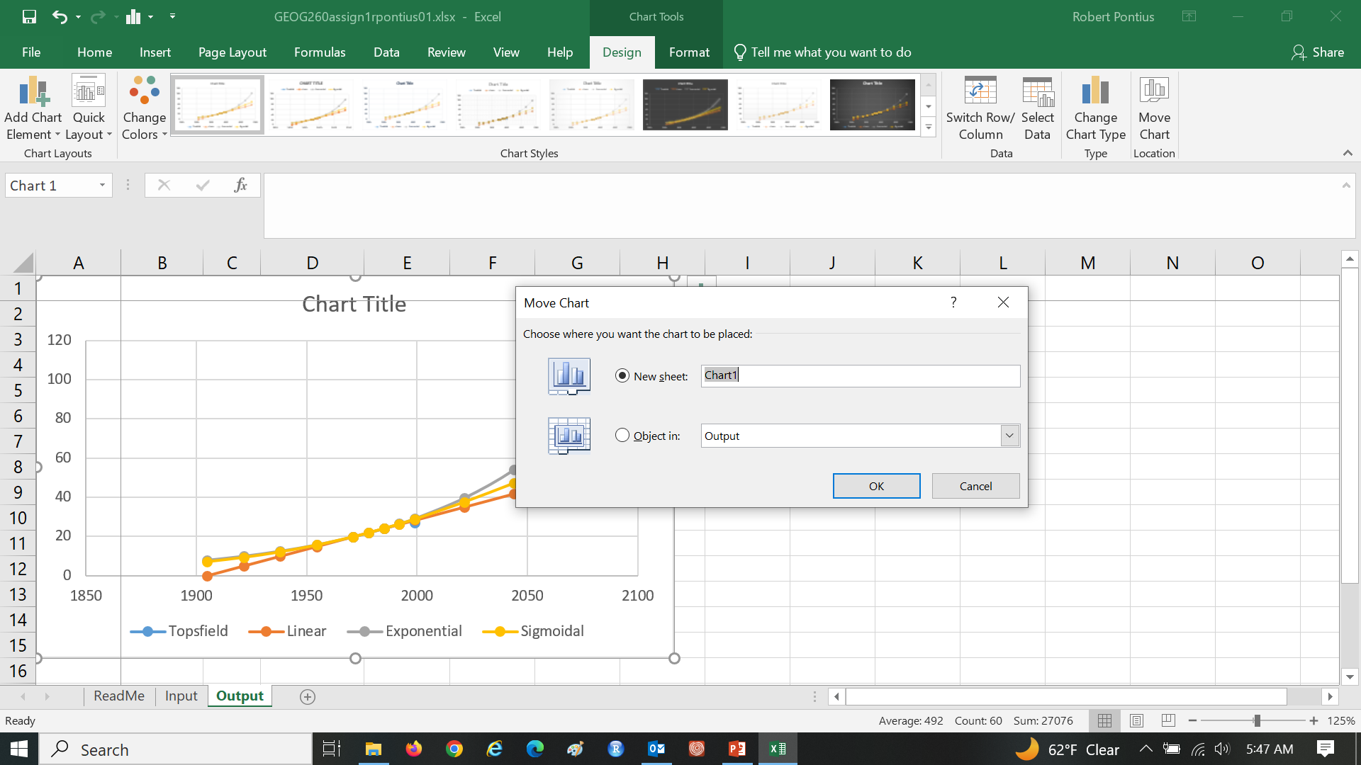
Assignment 1 Right click on Chart Area to Move Chart to a new sheet

Slide 54
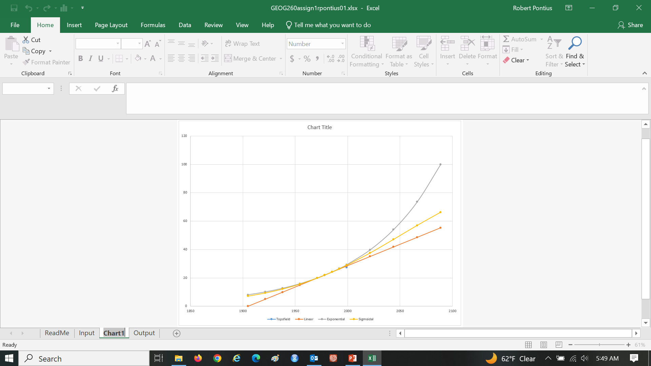
Assignment 1 Change Sheet name from Chart1 to Figure and move it to the far right

Slide 55
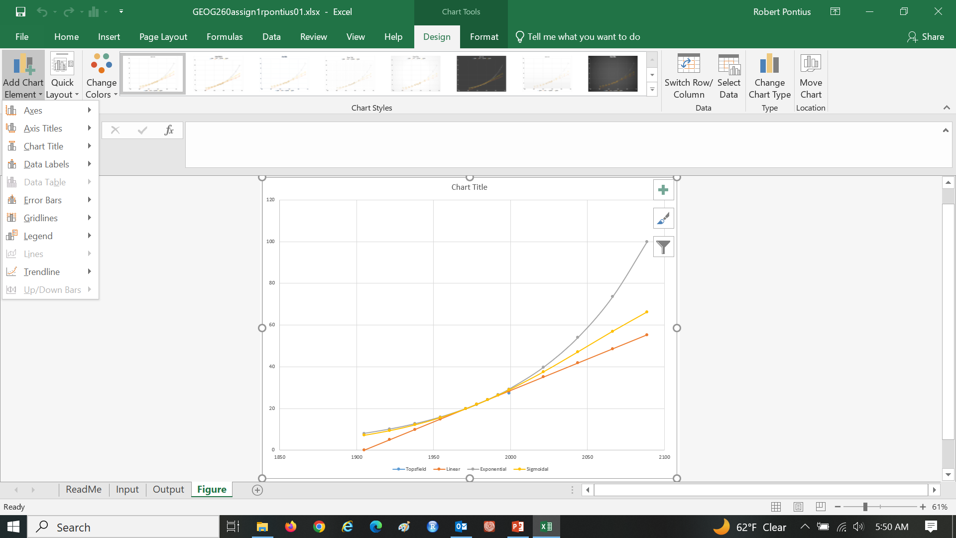
Assignment 1 Select Design then Add Chart Element to include Axis Titles

Slide 56
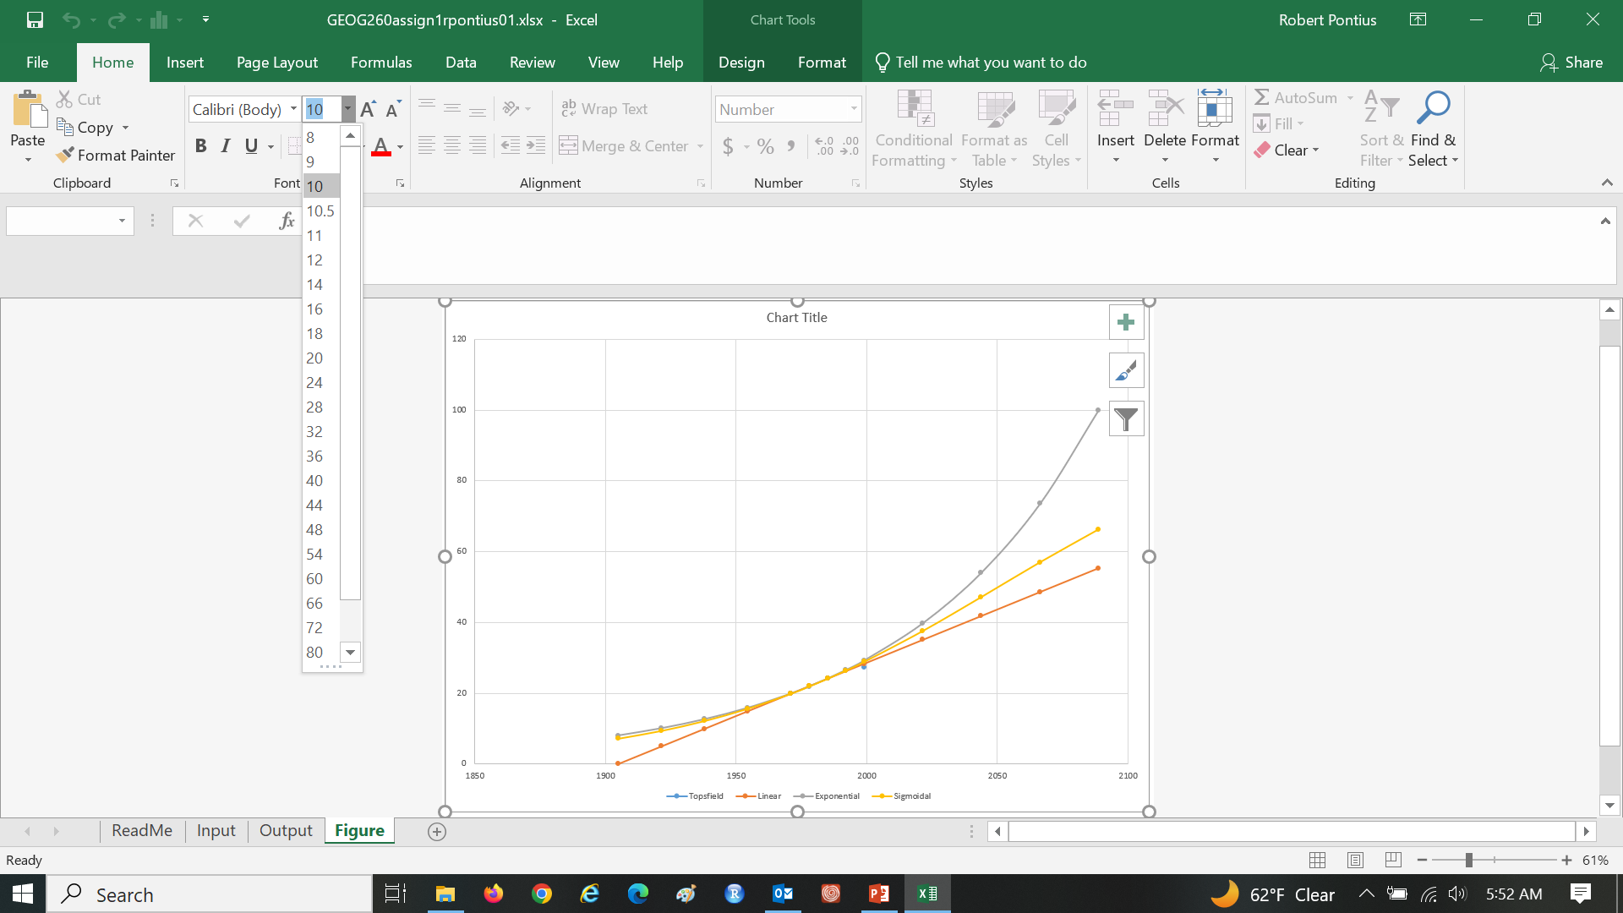
Assignment 1 Increase font size of everything

Slide 57
Assignment 1 Make the figure communicate as elegantly as this

Slide 58
Assignment 1 Make the figure communicate as elegantly as this

Slide 59
Assignment 1 Make the figure communicate as elegantly as this

Slide 60
Assignment 1 Make the figure communicate as elegantly as this

Slide 61
Assignment 1 Make the figure communicate as elegantly as this

Slide 62
Assignment 1 Make the figure communicate as elegantly as this

